Slide 1
GAMIT: Daily GPS processing
Lecture 2
Thomas Herring,
tah@mit.edu

Slide 2
GAMIT Overview
Discuss the setup, operation and options for GAMIT processing with sh_gamit
Areas:
  Directory structures
  Main functions in gamit: Programs called that run the gamit processing.
  Files that are important in processing
  Summary files
  Residual plots
  Problems that can happen and suggestions.

Slide 3
Basics
The scripts that control gamit and globk all have built in help which can be evoked by typing name. (~/gg/com contains all of the scripts used; ~/gg/gamit/bin and ~/gg/kf/bin contain the program executables; kf programs also have help output.
Once software is installed; user selects data to be processed over some interval of time and uses sh_gamit for the processing. Globk is used after the daily processing to combine results and set the reference frame.

Slide 4
Overview of sh_gamit: Getting started
To start sh_setup will create /tables, /rinex, /gsoln directories and then local specifics can be set.
  in ./tables, process.defaults and sites.default are the two main files that need to be edited; sittbl. may also need editing to ensure some constrained stations in the network to be processed; sestbl. is edited if non-standard processing.
  In ./tables, apriori coordinate file created (name in process.defaults). Additional coordinates are put into ./tables/lfile.
  in ./rinex, local rinex files need to be copied in; rinex data in archives will automatically be downloaded
sh_gamit -expt [expt-name] -s [yr] [start-doy] [stop-doy]
Common options are: -netext -yrext

Slide 5
Directory Structure
Top level: global tables and survey directories
Within each survey directory:
/tables /rinex /igs /gfiles /brdc /gsoln /glbf
/day1 /day2 (these directories are created as needed) …
Generally 50-60 sites is the largest network processed in GAMIT; larger numbers of stations require sub-netting of sites (see netsel, global_sel and sh_network_sel).
Tables are linked from day directories to experiment /tables and then to gg/tables
GAMIT processing occurs in the day directories
GLOBK processing occurs in /gsoln

Slide 6
sh_gamit internal operation:
The following programs are run by the script.
makexp and makex prepare the data
fixdrv prepares the batch control files
arc integrates GPS satellite orbits
model calculates theoretical (modeled) phase and partial derivatives of phase with respect to parameters
autcln repairs cycle slips, removes phase outliers, and resolves the wide-lane ambiguities
solve estimates parameters via least squares, resolving the narrow-lane ambiguities and creating an h-file for globk (user constraints are removed in the h-file to allow reference frame definition)

Slide 7
Steps in the standard GAMIT batch sequence
arc, model, autcln, solve for initial solution
  5-minute sampling, no ambiguity resolution (GCR only)
  update lfile. for coordinates adjusted > 30 cm
  look at --> autcln.prefit.sum, q<expt>p.ddd
model, autcln, solve for final solution
  2-minute sampling, ambiguity resolution
  Look at --> autcln.post.sum, q<expt>a.ddd
Final solution repeated if nrms reduced by > 30% from initial solution, to assure good editing and linear adjustment of parameters (original final-solution files overwritten)
Notes:
lfile. Is file with aptiori coordinates,

Slide 8
Files you need to worry about
RINEX files – local plus list in sites.defaults
Control files
process.defaults – minor edits for each survey
sites.defaults – sites to include/omit; source of metadata
sestbl. – unchanged for most processing
sittbl. – sites constrained for ambiguity resolution
globk_comb.cmd – use_site, apr_neu, apr_svs, apr_wob, apr_ut1, sig_neu, mar_neu
glorg_comb.cmd – apr_file, pos_org, stab_site
A priori coordinates ( apr-file, l-file )
Meta-data (station.info)
Differential code biases (dcb.dat) – download current values 1/month
Satellite characteristics (svnav.dat) – download current w/ each new launch
Notes:
Templates for these files are in the study notes. pp 5-11, and the individual entries are discussed in Chapter 2 of the Introduction to GAMIT/GLOBK and Chapter 3 of the GAMIT Reference Manual.

Slide 9
Files provided or created automatically
Satellite orbits
IGS sp3-files (tabular) and/or g-files (ICs for GAMIT)
ARC integrates to get t-files (tabular)
Earth Orientation Parameters ( ut1., wob.) - downloaded if needed for current day
Leap-second file -- linked to gg/tables (update ~yearly or when leap second)
Satellite clock (j-) files – from RINEX navigation (brdc) file
Rcvr/ant characteristics (rcvant.dat, hi.dat) – linked to gg/tables
Differential code biases (dcb.dat)—update ~monthly
Antenna phase center models (antmod.dat) – linked to gg/tables (also needs to be updated when new antennas added).
Luni-solar ephemerides and nutation (soltab., luntab., nutabl.) linked to gg/tables (need to update yearly)
Ocean tide grid (optional) – linked to gg/tables
Atmospheric loading grid (optional) – need to update yearly
Mapping function grid (optional) – need to update yearly
Notes:
ftp chandler.mit.edu and get files from source/incremental_updates/tables directory.

Slide 10
Options for metadata (station.info)
Pre-prepared station.info (make_stnfo, sh_upd_stnfo)
  Must set xstinfo in sites.defaults
RINEX headers (sh_gamit default: may change soon)
  Update station.info unless an entry already exists for the day being processed or stinf_unique is set to -u in process.defaults and entry has not changed
  Can be used with non-standard receiver and antenna names specified in guess_rcvant.dat (ideally your rinex files have the IGS official receiver and antenna names. It is critical that this information is correct.

Slide 11
A priori coordinates (sh_gamit)
Create l-file in day directory by merging existing lfile. and apr_file from ../tables (apr_file has priority)
If site not found in l-file
  Use RINEX header coordinates (use_rxc=Y in process.defaults, good for modern (post SA, in 2000) data.
  or
  Use pseudorange data in RINEX file to estimate point position or differential position relative to a site in sites.defaults (use_rxc=N, default)
During the sh_gamit run, the coordinates are updated (and copied to ../tables/lfile.) if they are in error by > 30 cm
Notes:
Why do we do have this scheme? Need to maintain get and maintain coordinates < 0.3 m
GAMIT runs from L-file, either the older spherical format or the newer Cartesian (GLOBK apr) format. The L-file is updated after each solve run with the new estimates if the adjustments exceed the ‘Update tolereance’ (usually 0.3 m) in the sestbl. In sh_gamit processing, these values are carried forward to the next day except that at the beginning of each day, the coordinates in the L-file for any site appearing in the ‘apr_file’ (named in process.defaults), which usually includes ITRF sites and any regional sites for which previous processing has achieved precise coordinates.

Slide 12
Ambiquity resolution
(L2-L1) integers resolved by autcln and passed to solve in the n-file ( LC_AUTCLN option)
  weak dependence on geometry
  need current dcb.dat file
  use LC_HELP for codeless data ( before ~1995) or if problems (default max distance is 500 km)
Narrow-lane (L1) resolved by solve
  strong dependence on phase noise and models
  5-10 cm constraints on a priori coordinates usually sufficient
Notes:
Confusing topic without knowing theory. Come back to later in the afternoon if requested.

Slide 13
sh_gamit_ddd.summary (email)
Contents (Purple is output):
Input options -d 2002 30 31 32 33 -expt ncar -pres ELEV -yrext -netext a
Processing 2002 031 GPS week 1151 4 Raw 2
/data51/tah/SENH02/glob02/suomi/2002_031a
Disk Usage: 12678.4 Free 76447.4 Mbyte. Used 15%
Summary Statistics ( from autcln )
Number of stations used 4 Total xfiles 4
Postfit RMS rms, to and by satellite
RMS IT Site All 01 02 03 04 05 06 07 08 09 …
RMS 20 ALL 4.8 4 5 6 5 5 4 5 4 5 …
Best and Worst two sites:
RMS 20 TMGO 3.2 3 3 4 4 4 3 3 3 4 …
RMS 20 SA09 4.6 4 4 5 4 5 4 4 4 5 …
RMS 20 PLTC 5.4 4 5 5 6 5 4 5 5 6 …
RMS 20 SA13 5.5 5 5 6 5 5 5 5 5 6 …
Notes:
See also the example on p. 4 of the WS Notes.
Two parts: autcln summary and q-file.
This slide shows the top part of the summary file, comprising statistics extracted from autcln

Slide 14
sh_gamit_ddd.summary (email)
Solution statistics from solve
Double difference statistics
Prefit nrms: 0.31280E+03 Postfit nrms: 0.21324E+00 Constrained free
Prefit nrms: 0.31185E+03 Postfit nrms: 0.21818E+00 Constrained fixed
Prefit nrms: 0.31272E+03 Postfit nrms: 0.20470E+00 Loose free
Prefit nrms: 0.31185E+03 Postfit nrms: 0.20756E+00 Loose fixed
Number of double differences: 12447
Numbers of WL and NL biases 120 Perscent fixed 95% WL 85% NL
Any large adjustments to positions (>0.3 m)
Things to note:
  Number of stations matches expectation
  Site postfit RMS values 3-10 mm
  No stations with RMS = 0 ( implies no data retained by autcln )
  Postfit nrms from solve ~0.2 for constrained and loose solutions
  “Most” ambiguities resolved (70-85% for noisy days, > 90% for best)
Notes:
The statistics in the bottom part of the summary have been extracted from the q-file.

Slide 15
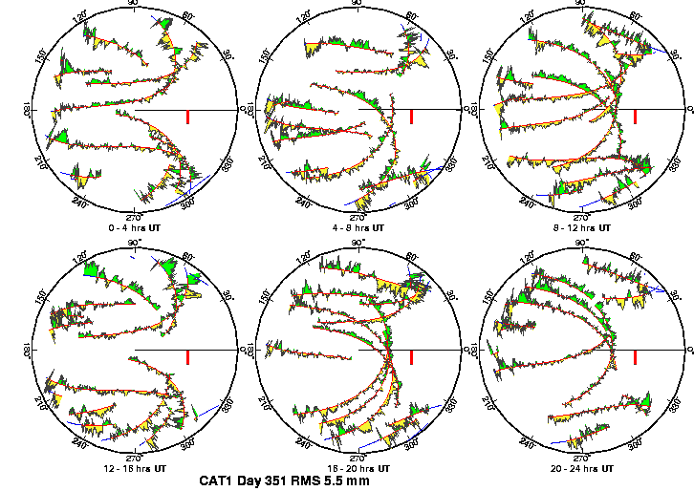
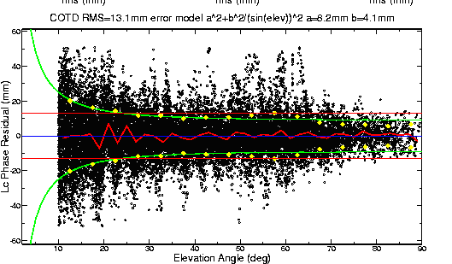
Phase Residual Plots
Set with -pres elev in sh_gamit command line (requires GMT)
Postscript files in day directory, by default converted to gif in /gifs directory and then erased (needs ImageMagik convert program).
Use to assess multipath, water vapor, and antenna phase center model
“Sky plot” Phase vs elevation angle
Notes:
The sky plots produced using the –pres ELEV command-line option of sh_gamit (or separately with sh_sky_gifs), are the most accessible source of detailed knowledge about conditions of session: multipath, atmosphere, receiver performance. In sky plots, red is the satellite track; yellow and green are positive and negative residuals, colored differently only to aid the eye; red bar is scale (10 mm). In right plot, all satellites are included. Red line is the average, green the envelope representing the constant + elevation-dependent noise model computed by autcln and passed to solve in the n-file for the final solution

Slide 16
High residuals in the same place at different times suggest mulitpath
High residuals appearing in a given place only at one time suggest water vapor
Notes:
Later this afternoon when we talk about height, we’ll look at what you can learn in detail from these plots

Slide 17
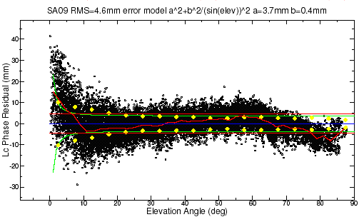
Phase vs elevation angle
Normal pattern: bands are high-frequency multipath; red is smoothing of individual values, showing no strong systematics. Mid-elevation angle noise could be atmospheric delay errors?
Bad pattern: systematic signature of smoothed values indicates a poor model of the antenna phase pattern (perhaps a misidentified antenna in station.info)
Green lines show the elevation-dependent noise model shown at top and used to reweight the data in solve
Notes:
Large excursion is below 10 deg but still systematic above 10 deg
THIS IS LAST SLIDE for presentation.

Slide 18
What can go wrong?
Site missing (not listed)
  no RINEX data within session span: check RINEX file and/or makex.expt.infor
  too few data, x-file too small and not used: check RINEX file size, change minxf in process.defaults
Site in solution but no data or adjustment
  a priori coordinates > 10 m off: check range rms in autcln.prefit.sum,
    run sh_rx2apr differentially for several RINEX files
  bad receiver: examine RINEX files or initial c-files with cview
Q-file nrms > 0.2
  solution over-constrained: check GCX vs GLX nrms, rerun with only one site constrained
Notes:
Next few slides look at each of these problems.

Slide 19
Problems with a priori coordinates
Need to be good to < 10 m to get through autcln
Safest source is a previous solution or a pseudorange solution using svpos/svdiff (sh_rx2apr)
Range rms and bias flags added from autcln summary file are a useful check
Convergence is 1:100 to 1:1000 (1 m error in apr can lead to 1-10 mm error in adjustment)—hence automatic update of L-file for GAMIT 2nd solution
Watch for repeated updates in email summary as a sign of bad data

Slide 20
Constraining the GAMIT solution
Minimal (single-station) constraint is all that’s needed for ambiguity resolution, but sittbl. can list several to assure one
Orbits can be fixed or tightly constrained (.005 ppm) for IGS orbits since at least 1996. Use of baseline mode (no orbit estimated now recommended for regional processing.
Look for good (~0.2) loose (GLR/GLX) nrms but elevated constrained nrms (GCR/GCX) as indication of an over-constrained solution
Notes:
If using GLOBK for final solution, you can constrain the frame more rigorously there, so for GAMIT, just provide a minimal constraint to assess data quality.: low nrms, small adjustments to all parameters.

Slide 21
More Subtle Problems
Site with high rms in autcln.post.sum
  high multipathing or water vapor: check sky plots of phase
  bad receiver: examine RINEX files or initial c-files with cview
Phase vs elevation angle plot large and systematic
  misidentified antenna (wrong PCV model)
  coupling between antenna and mount (discussed during height section)
GAMIT results within normal range but time series shows outlier
  survey-mode: antenna not leveled and centered over mark
  change in multipath (water, objects) or water vapor
  snow on antenna
  incorrect ambiguity resolution (east component except for high latitudes)
Notes:
These are somewhat overlapping, both with the three major problems discussed on the previous slides, and with each other. They provide a conceptual structure with which to look at the plotting tools available for diagnostics.

Slide 22
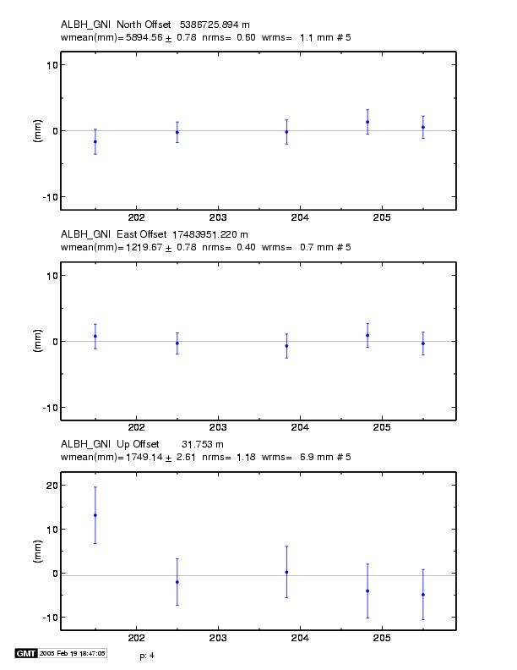
Example of understanding outliers
Autcln rms
Day 201 9.6 mm
Day 202 6.0 mm
Notice height outlier on Day 201
Notes:
Time series (from sh_glred) showing an outlier on day 201. Why?
Probably troposphere since in height and we don’t expect multipth to change (though it can)

Slide 23
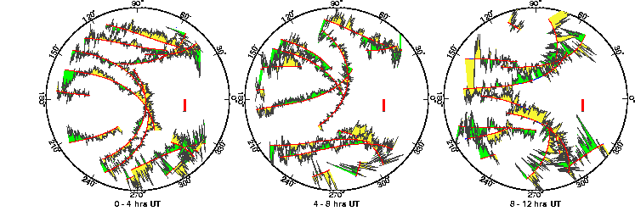
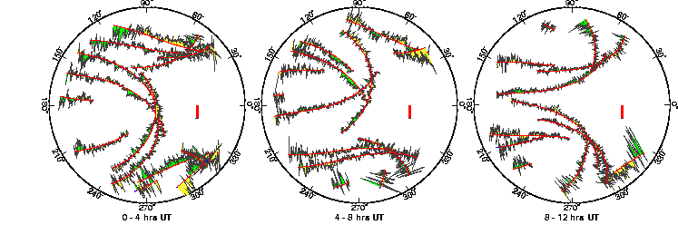
ALBH 2003 Day 201
ALBH 2003 Day 202
Notes:
In fact, day 201 (the outlier) has significantly higher phase noise than day 202. Since the pattern is different on the two days, the cause must be water vapor rather than multipath.

Slide 24
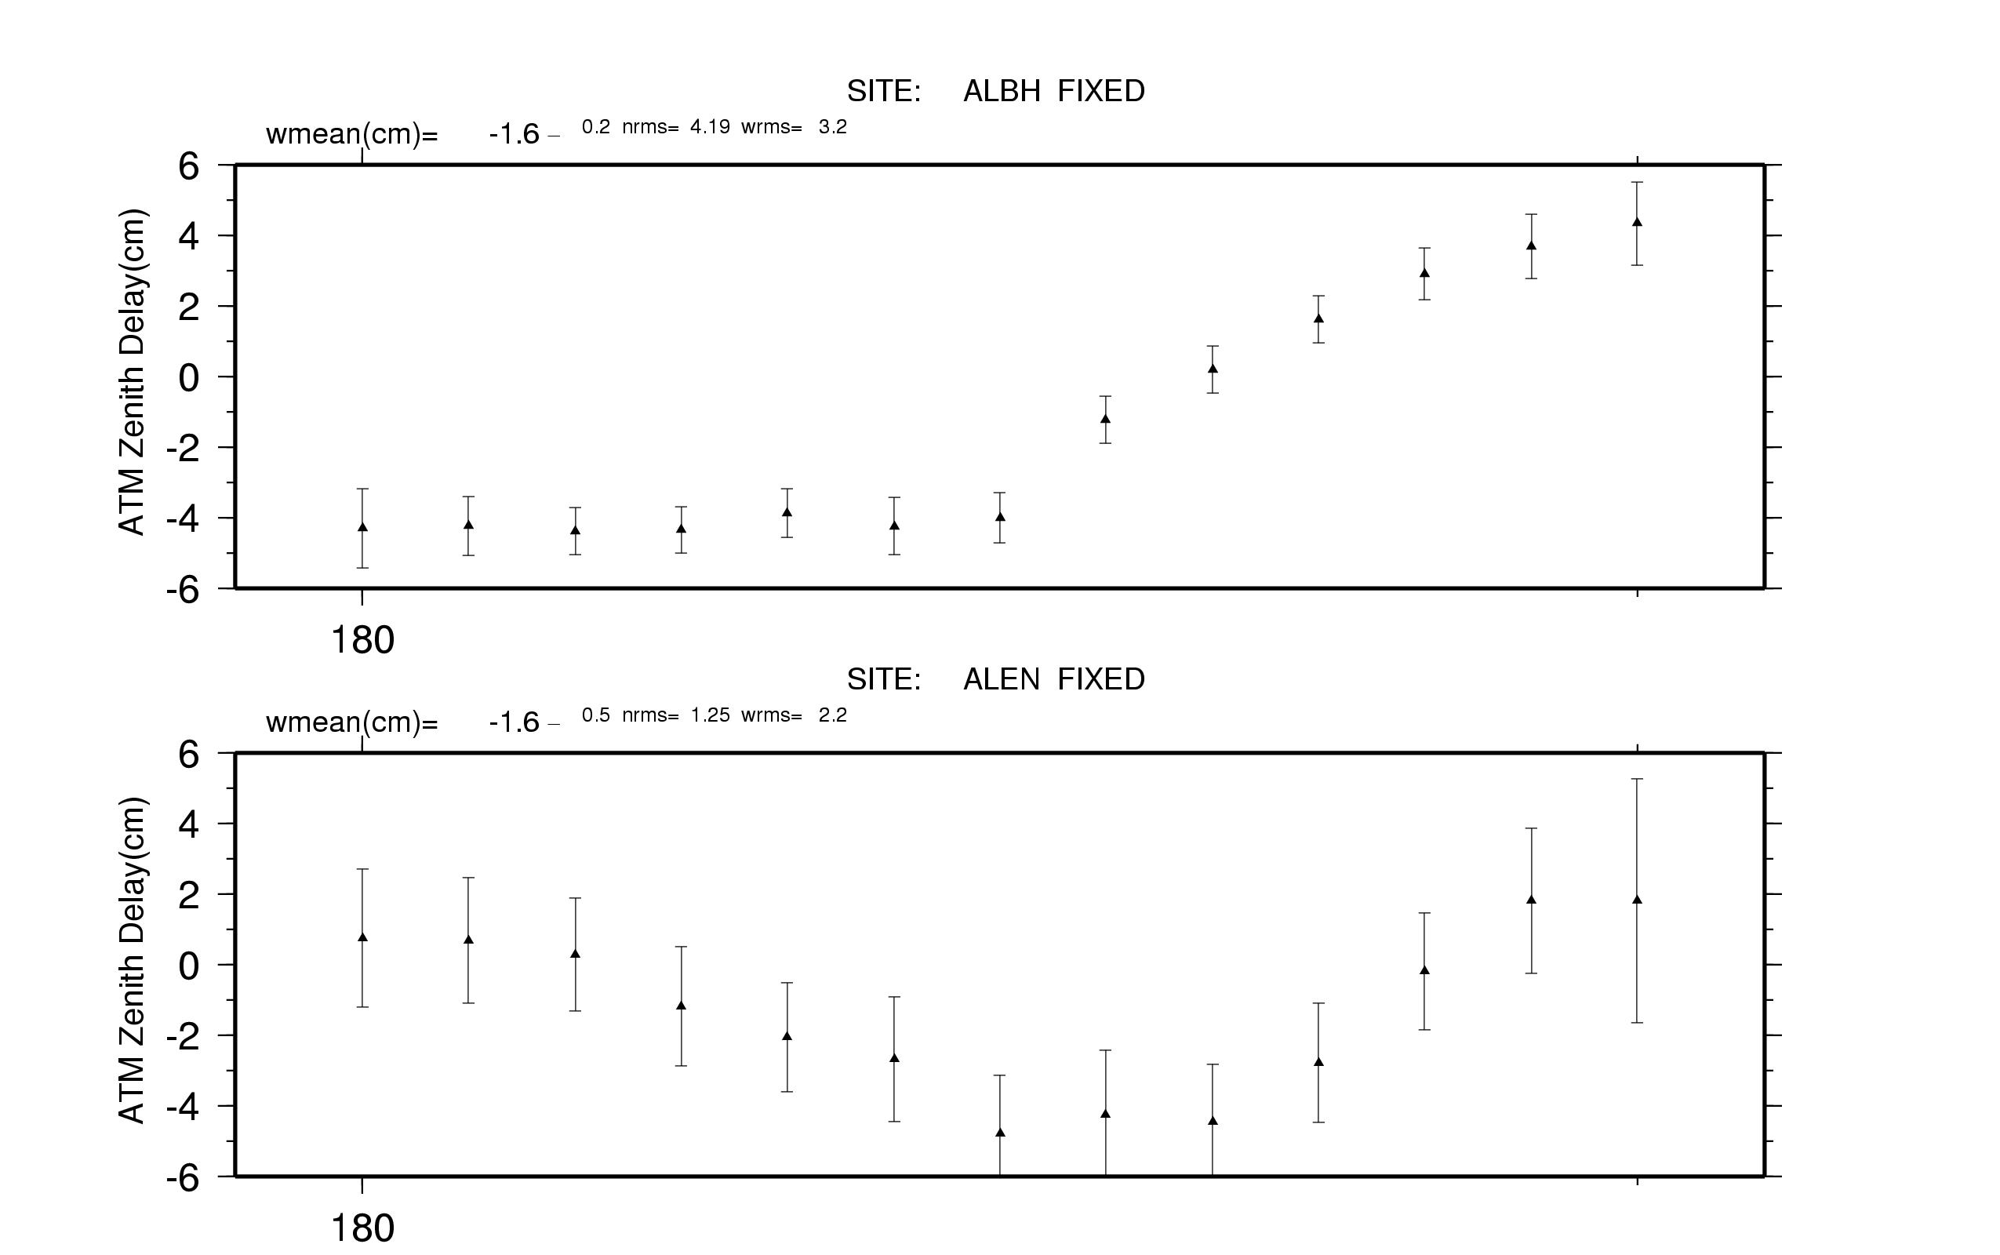
GPS adjustments to atmospheric zenith delay for 29 June, 2003; southern Vancouver Island (ALBH) and northern coastal California (ALEN). Estimates at 2-hr intervals.
Notes:
The atmospheric delay can vary by decimeters, and though the surface pressure provides an adequate calibration of the the gases in hydrostatic equilibrium, there is no reliable and economical way to remove the contribution of water vapor. So we estimate that portion, parameterized by a delay at the zenith and a mapping function that is reliable to 15 degree elevation angle, the usual lower limit for GPS observations. This slide shows the estimates at 2-hr intervals for two stations used in our analysis of PNW data from last summer.

Slide 25
Summary
The sh_gamit script is used to automate processing and once set-up usually operates with no human interaction.
In tutorial session, we will set up run to illustrate operation.

