Slide 1
Geodetic Imaging from Space
Thomas Herring,
Department of Earth, Atmospheric and Planetary Sciences
tah@mit.edu
http://geoweb.mit.edu/~tah

Slide 2
Geodetic Imaging
What is geodetic imaging?
Geodesy is the science of measuring the size, shape and gravity field of the Earth and the rates of change of these quantities.
Modern positioning systems allow image type data to be used for precise measurements of changes in position.
The registration and time changes of these image type data is made possible by the global positioning system (GPS).
In this seminar we explore some of these geodetic imaging techniques and their applications.

Slide 3
Overview
Progress in positioning technology has been dramatic in the past 2 decades:
  Global millimeter positioning of quasi-static points
  Centimeter level positioning of rapidly moving bodies (aircraft, cars, etc.)
  Imaging deformation with centimeter accuracy and spatial resolution of 30-meters over spatial distances of 10-100km.
These capabilities are made possible with the Global Positioning System (GPS), Interferometric Synthetic Aperture Radar (InSAR), airborne LIDAR and spatial image analysis.
We start by looking at GPS and how it has revolutionized global positioning.

Slide 4
Methods
Global positioning system (GPS), now sometimes referred to as GNSS, global navigation satellite system, to include the Russian GLONASS system, the European Galileo system, and the Chinese compass system.
  Dense networks of GPS sites that have almost image like qualities.
Interferometric synthetic aperture radar, InSAR.
Airborne laser altimeter systems, LIDAR
Optical image comparisons using satellite and aircraft imagery.

Slide 5
GPS Design
Started development in the late 1960s as NAVY/USAF project to replace Doppler positioning system. First prototype satellite launched in 1978; operational 1992.
Aim: Real-time positioning to < 10 meters, capable of being used on fast moving vehicles.
Innovations:
  Use multiple satellites (originally 21, now ~28-32)
  All satellites transmit at same frequency
  Signals encoded with unique “bi-phase, quadrature code” generated by pseudo-random sequence (designated by PRN, PR number): Spread-spectrum transmission.
  Dual frequency band transmission:
    L1 ~1.575 GHz, L2 ~1.227 GHz, L5 ~ 1.177 GHz (II-F satellites)
    Corresponding wavelengths are 190 mm, 244 mm, 255 mm.

Slide 6
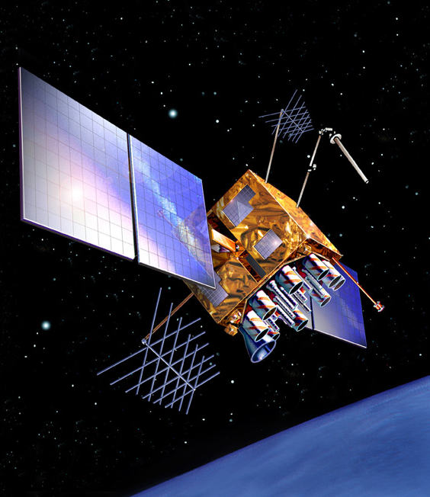
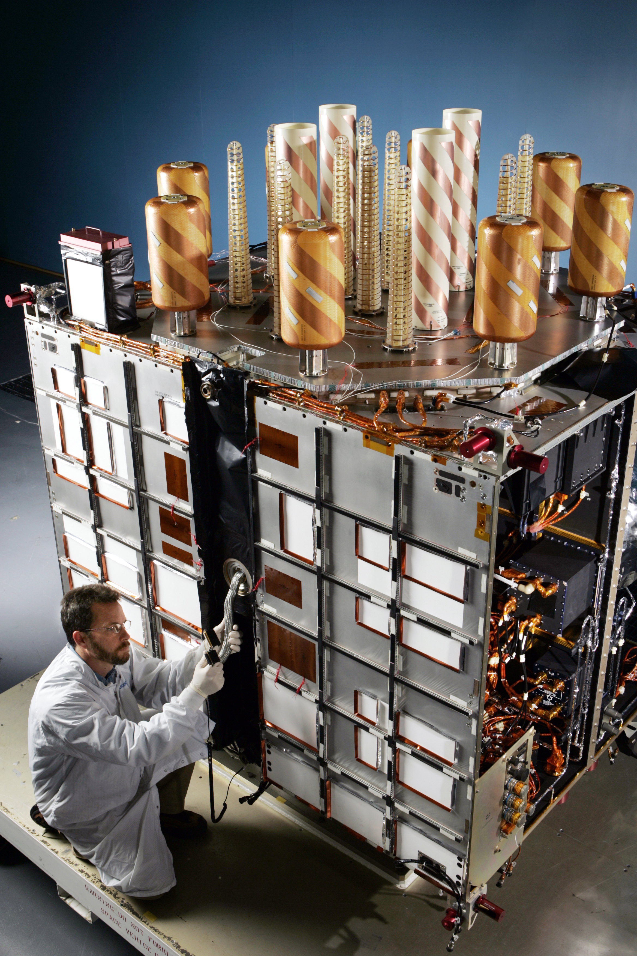
GPS Block IIRM satellite
1100 kg weight
Notes:
http://www.lockheedmartin.com/wms/findPage.do?dsp=fec&ci=11474&rsbci=0&fti=126&ti=0&sc=400

Slide 7
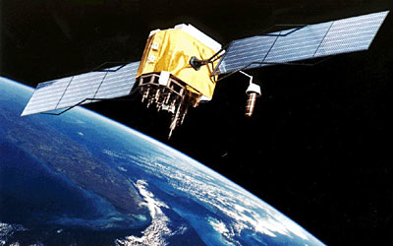
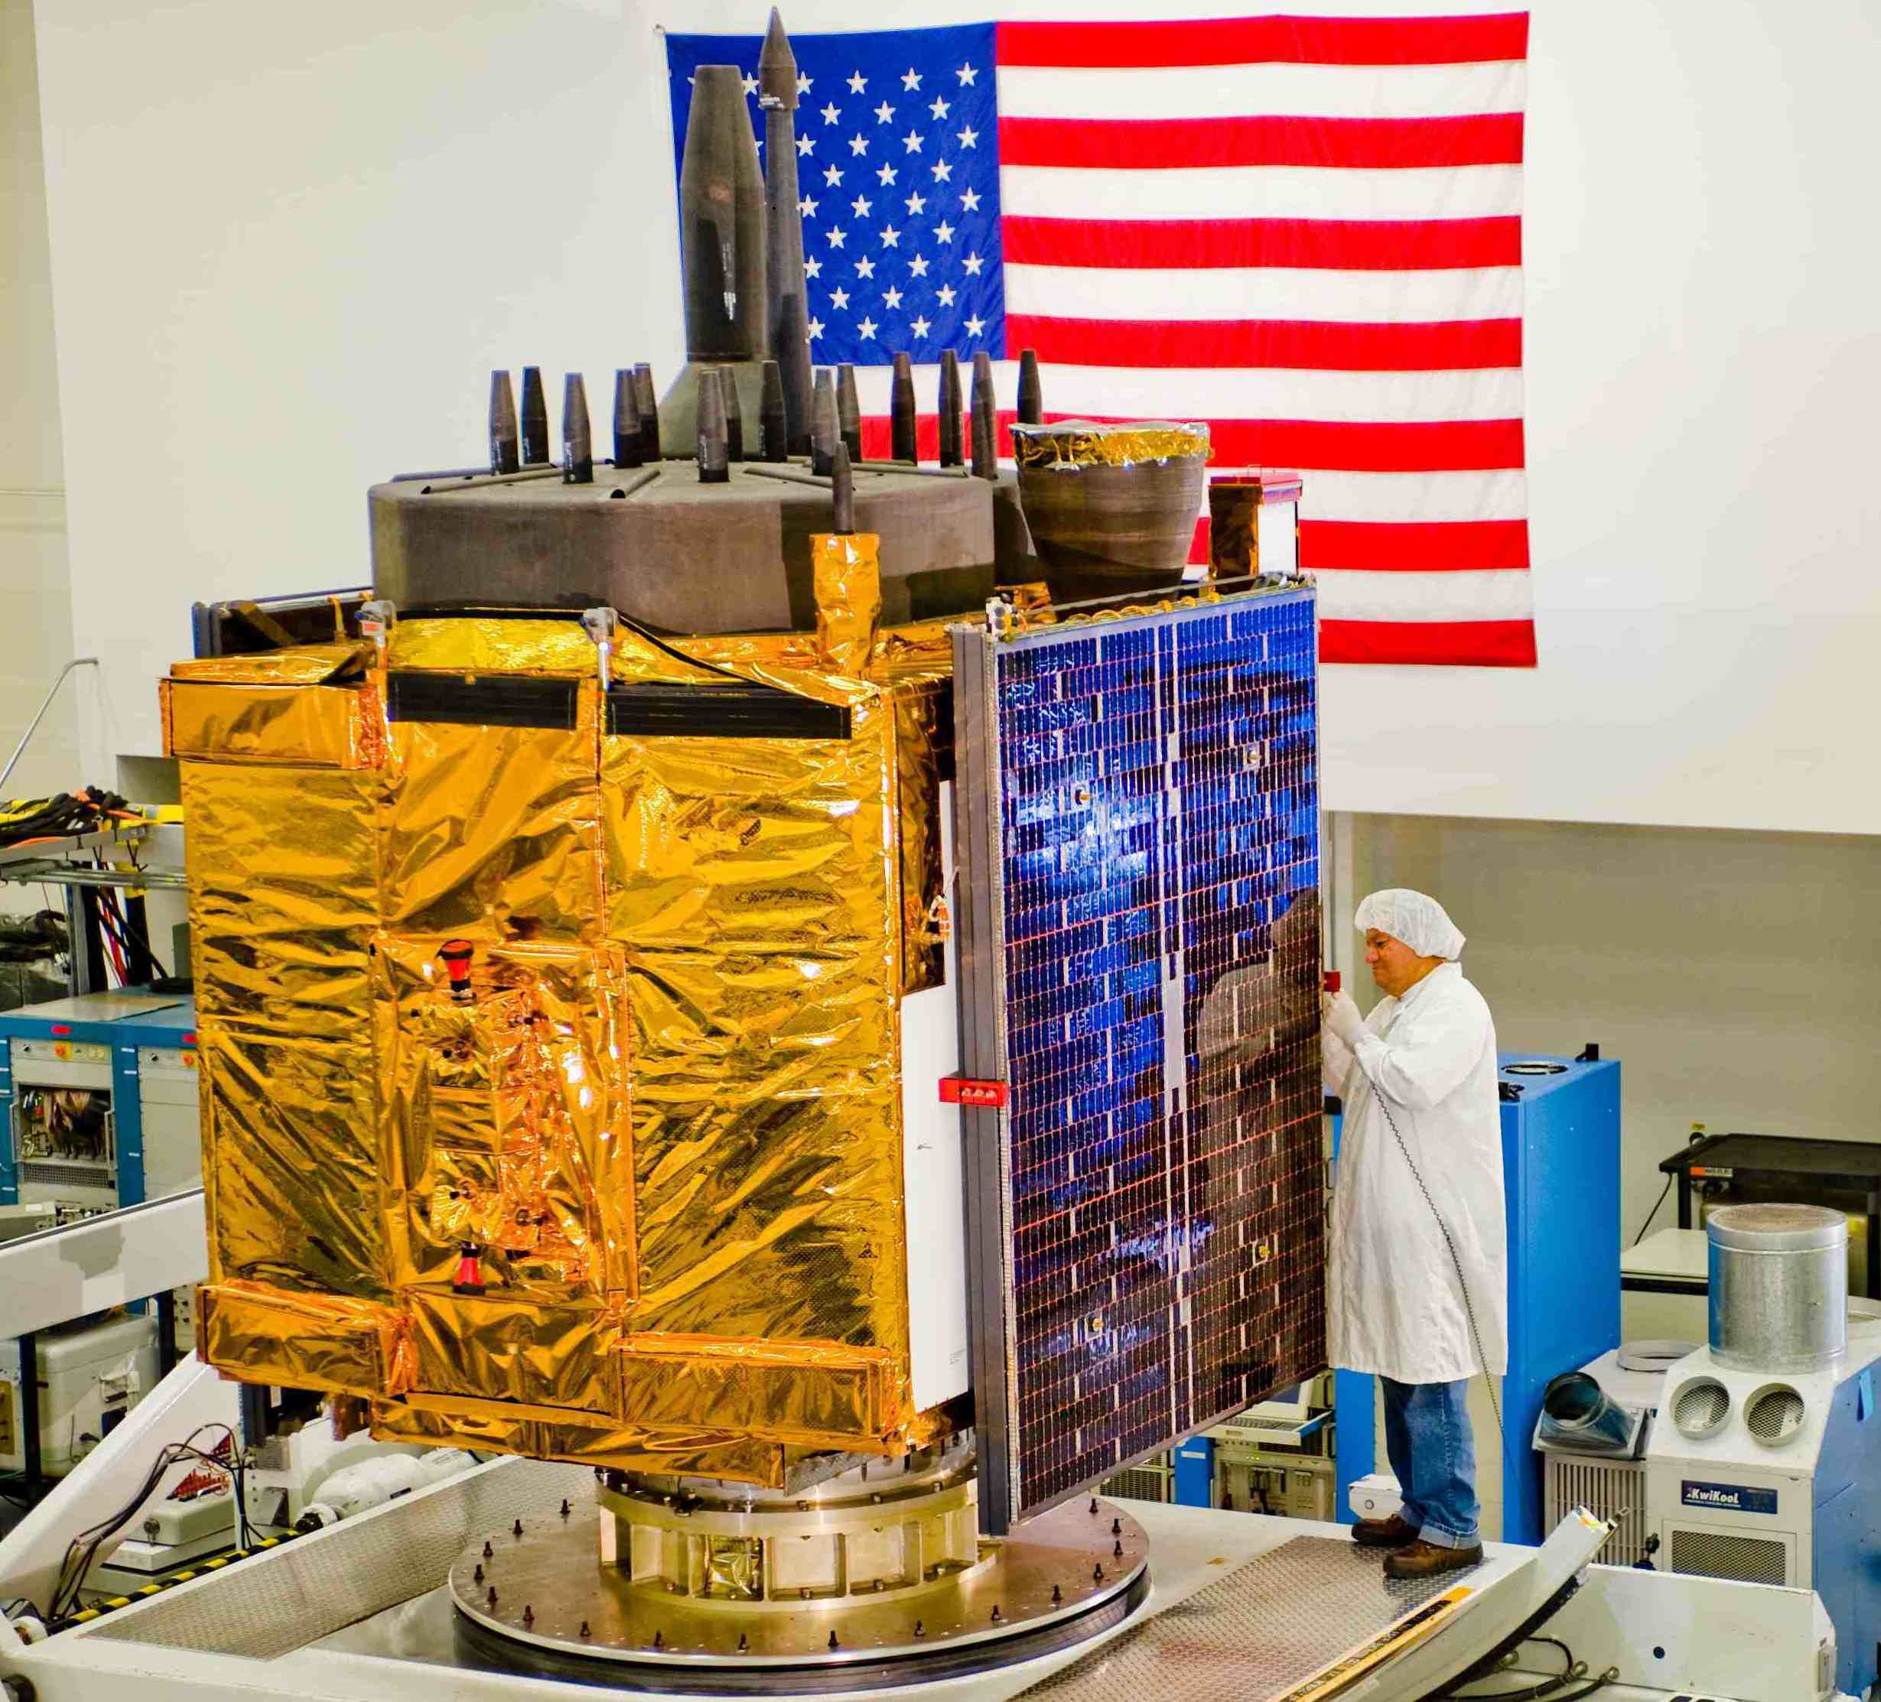
GPS IIF satellites
First launch May 28, 2010.
Weight 1555 kg
L5 signal transmitted by these satellites
Notes:
http://www.insidegnss.com/auto/storyimage/GPS%20IIF-assembly-Flag.jpg
http://www.yenra.com/gps-2f/gps-2f.jpg (II-F image)

Slide 8
Measurements
Main measurements:
  Time difference between signal transmission from satellite and its arrival at ground station (called “pseudo-range”, precise to 0.1–10 m)
  Carrier phase difference between transmitter and receiver (precise to a few millimeters)
All measurements relative to “clocks” in ground receiver and satellites. By being able to simultaneously make measurements to multiple satellites, these clock errors can be eliminated.
Bi-phase encoding of signals in a pseudo-random pattern (PRN) allows multiple satellites all transmitting at same frequency to be observed.
Due to simultaneous observations, clocks and local oscillator phases can be largely eliminated.
Notes:
Doppler is only 5-KHz (BW 1-10 MHz).

Slide 9
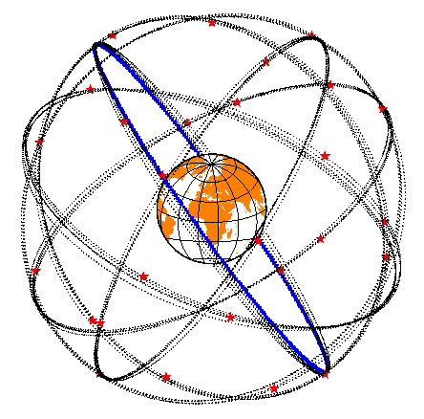
GPS Constellation (MEO at 20000km altitude)
• Relative sizes correct (inertial space view)
• “Fuzzy” lines not due to orbit perturbations, but due to satellites being in 6-planes at 55º inclination.
Originally 21 satellites now 30-32

Slide 10
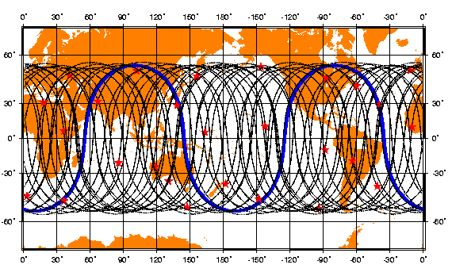
Ground Track
Paths followed by satellite along surface of Earth.

Slide 11
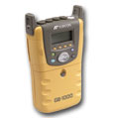
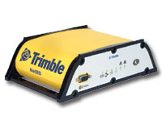
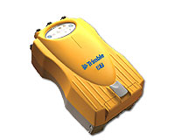

GPS Receivers (Geodetic)
Units weight ~1kg and are ~10cm per side
http://www.leica-geosystems.com/
http://www.trimble.com/
http://corp.magellangps.com/
http://www.topconpositioning.com/

Slide 12
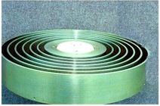
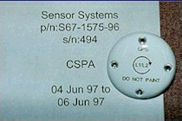
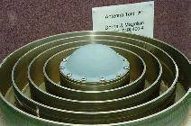
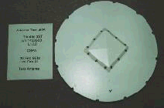
GPS Antennas (for precise positioning)
Nearly all antennas are patch antennas (conducting patch mounted in insulating ceramic).
• Rings are called choke-rings (used to suppress multi-path)

Slide 13
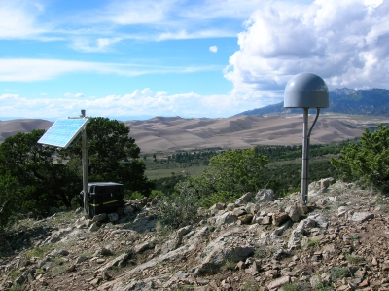
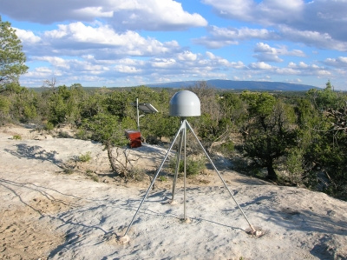
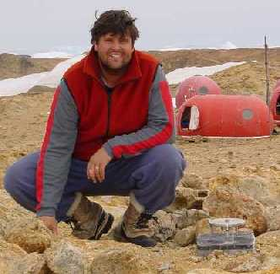
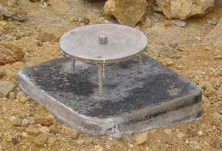
Styles of Monuments

Slide 14
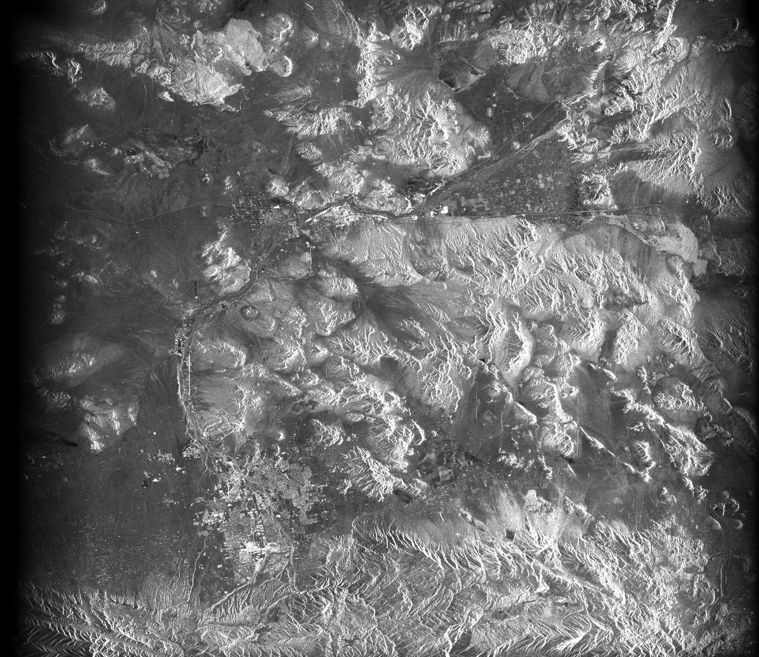
Synthetic Aperture Radar (SAR)
A satellite-borne radar system illuminates a swath of
ground with pulses of RF energy
flight track
ERS-1 SAR amplitude image over
Landers, CA
slant
range
chirp
pulse
N
Barstow, CA
Flight track / azimuth
ground range
SAR image
Pulse compression focuses echoes in range
Doppler analysis focuses echoes in azimuth
16 km
range
Notes:
14

Slide 15

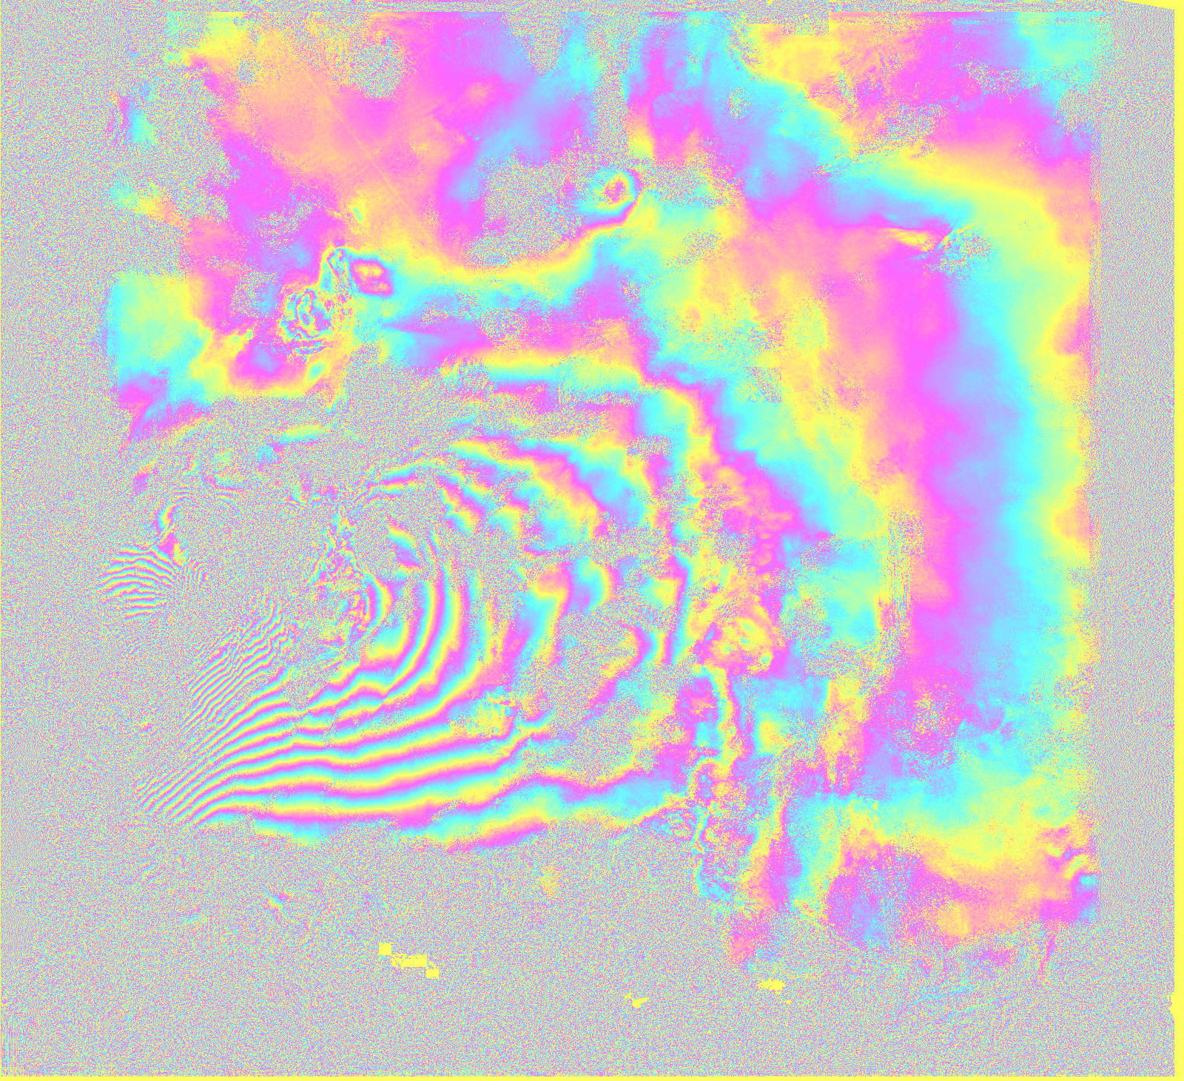

InSAR images of ground motion
If the scatterers on the ground move between radar
observations then there are additional phase shifts
due to line-of-sight change in range
baseline
Radar interferogram over Landers, CA
with topographic phase removed
r₂
H
r₁
N
Flight track / azimuth
Topographic contribution of phase is
removed using a digital elevation model
(DEM)
Radar interferogram of the Landers, CA
June 28th 1992 M7.3 earthquake
16 km
2π phase = 2.86 cm
range change
Notes:
15

Slide 16
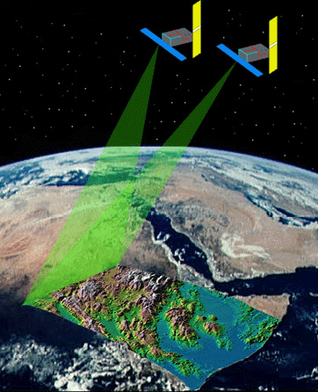
InSAR in Brief
Provides line-of-sight surface displacement maps
Spatial resolution 5 to 20 meter or at persistent scatterer locations.
Centimeter-level precision
Global coverage
25-35 day temporal sampling depending on satellite
Ascending + descending orbits: provide east-west and vertical displacement fields
Sensitivity to atmospheric propagation delays.
Possible “tilts” in images due to orbit errors.
Provides good spatial when returns are coherent but low temporal resolution.
Look-angles 23-45 degrees depending on satellite
Notes:
16

Slide 17
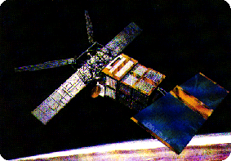
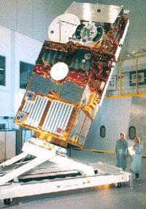
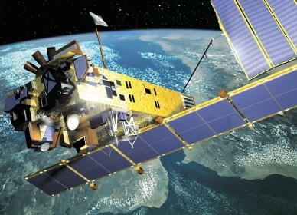
EnviSat InSAR satellite
Radar antenna
Notes:
Images from http://www.naturalsciences.be/institute/structure/geology/gsb_website/research/satellite/satellite

Slide 18
LIDAR (Laser Altimetry)
This method of measuring distance from aircraft to the ground using pulsed laser.
Footprint on the ground is 3-10 cm, range accuracy <1 cm, measurement 10-1000 Hz. Method paints a picture the heights of the surface.
Quantitative evaluation of the results is possible because of centimeter level positioning of the aircraft in flight.

Slide 19
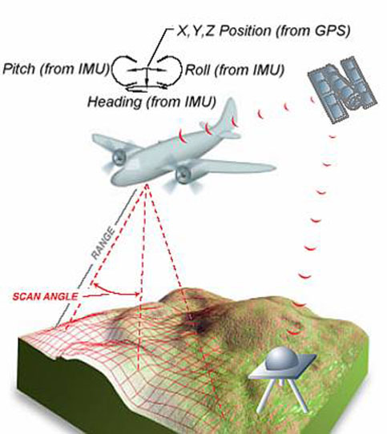
LIDAR method
Schematic of method:
  GPS positions the aircraft;
  Inertial measurement units (IMU) yield direction of laser
  Scanning allows a swath of land to be covered
Land heights ±2-5 cm with 10-50 cm pixels
Notes:
http://www.dot.state.oh.us/Divisions/Engineering/Aerial/PublishingImages/Remote%20Sensing/Picture2.jpg

Slide 20
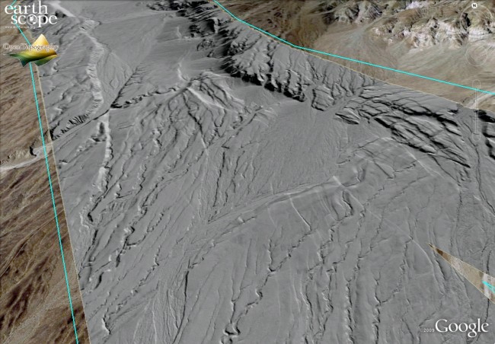
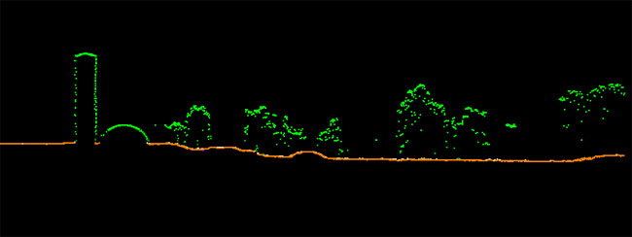
LIDAR Visualizations
Methods of displaying results
Shaded relief, profiles
Notes:
http://www.dot.state.oh.us/Divisions/Engineering/Aerial/PublishingImages/Remote%20Sensing/microstation01.jpg

Slide 21
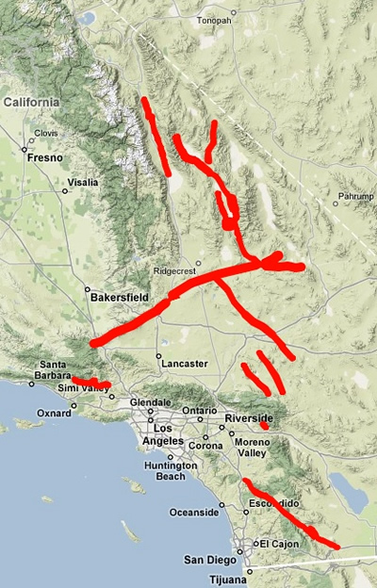
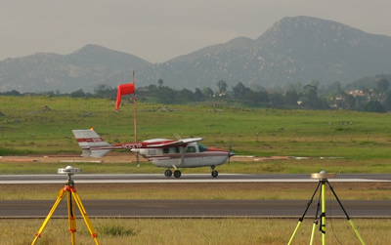
Example
Measurement in California. When an earthquake occurs, height images can be compared to generate estimates of deformations
Notes:
Images from http://facility.unavco.org/highlights/2008/geo-es-lidar-3-DSC_1618.jpg
http://facility.unavco.org/highlights/2008/geo-es-lidar-1-SoCal_LiDAR_Map.jpg

Slide 22
Examples of the applications of these methods
GPS applications
  The International GPS/GNSS Service (IGS) tracking network. Loose international collaboration that now supports several hundred, globally distributed, high accuracy GPS receivers. (http://igscb.jpl.nasa.gov)
  Applications in Western United States: The Plate Boundary Observatory (http://pboweb.unavco.org/)
InSAR (fast) examples
  Volcanic and Ice motion examples
Examples from recent Baja 2010 and Tohoku 2011 earthquakes.

Slide 23
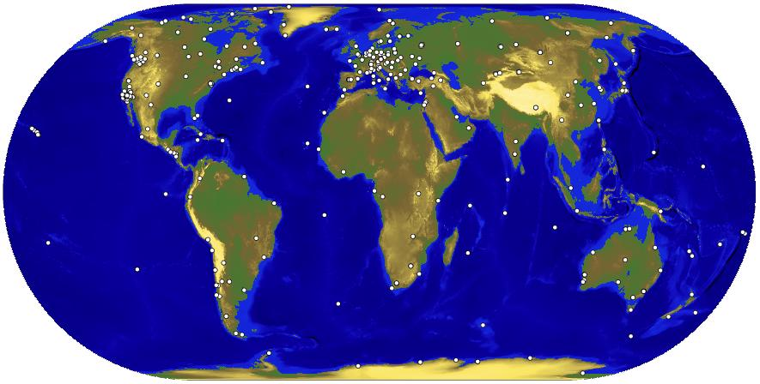
IGS Network
Currently over 400 stations in network

Slide 24
Uses of IGS data
Initial aim was to provide data to allow accurate determination of the GPS satellite orbits: Since IGS started in 1994, orbit accuracy has improved from the 30 cm to now 2-3 cm
From these data, global plate motions can be observed in “real-time” (compared to geologic rates)
Sites in the IGS network are affected by earthquakes and the deformations that continue after earthquakes. The understanding of the physical processes that generate post-seismic deformation could lead to pre-seismic indicators:
  Stress transfer after earthquakes that made rupture more/less likely on nearby faults
  Material properties that in the laboratory show pre-seismic signals.
Meteorological applications that require near real-time results

Slide 25
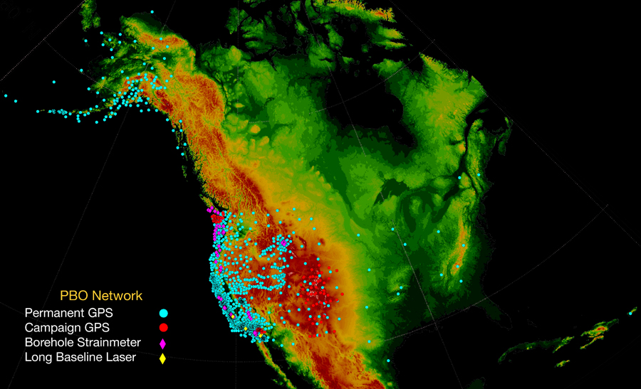
Plate Boundary Observatory (PBO)
1300 continuously operating sites GPS (Japan has 1500 in much smaller area)

Slide 26
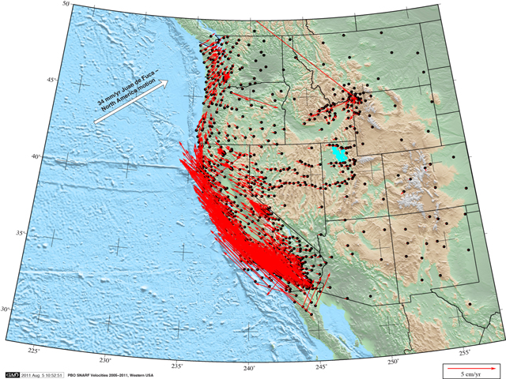
PBO Velocity field

Slide 27
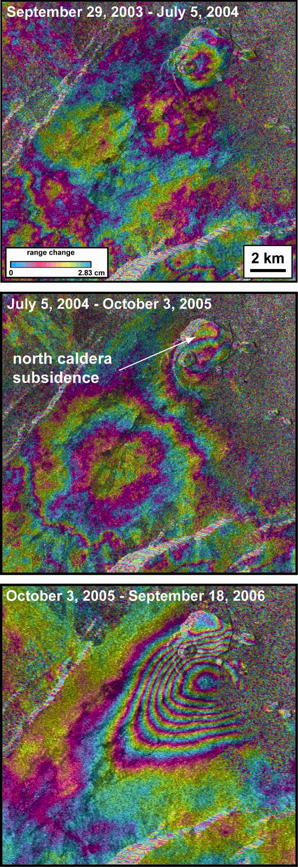
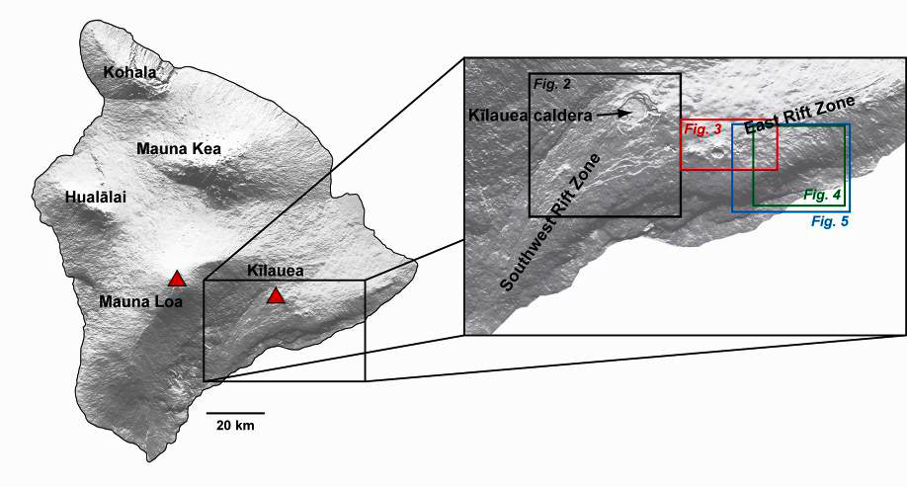
Monitoring Kilauea
InSAR provides a remote way to monitor active volcanos. Rapid motions before eruptions. Provides models of magma movements.
“Monthly” measurements
Color fringe is 28 mm; line of sight change
Poland (2007)
Notes:
ASAR IMAGES A DIVERSE SET OF DEFORMATION PATTERNS AT KĪLAUEA VOLCANO, HAWAI`I Michael P. Poland⁽¹⁾

Slide 28
Recent Large Earthquakes
Baja Earthquake
  Magnitude 7.2, April 4, 2010 (similar to Haiti)
  Epicenter N 32.13 W 115.30 deg, Depth 26 km
  http://www.unavco.org/community_science/science_highlights/2010/M7.2-Baja.html
Tohoku 2011 earthquake
  Magnitude 9.0, March 11, 2011 14:46 JST (05:46 UTC)
  Epicenter N 38.29 E 142.40 deg, Depth 32 km
  Super site:
  http://supersites.earthobservations.org/sendai.php

Slide 29
El Major-Cucapah Earthquake Apr 2010
Seismicity in the region

Slide 30
Earthquake analysis
Analysis of seismic data, GPS, InSAR, SPOT image lead to model of the earthquake with 3 different rupture phase.
Event started with a small earthquake which triggered the larger pairs

Slide 31
Coseismic results from April 4, 2010 Baja 7.2 Earthquake
(El Major Cucapah earthquake)

Slide 32
Combined Model Fits
GPS horizontal and vertical motions and model fit to these data.

Slide 33
InSAR Results
InSAR imaging of the displacements due to the earthquake.
Each color band is 11.8 cm (0-2π radians phase difference)

Slide 34
SPOT sub-pixel correlation analysis
Combination of displacements measured by image comparison of SPOT images and SAR images using COSI-Corr (Co-registration of Optically Sensed Images and Correlation) [Leprince et al., . Ieee Transactions on Geoscience and Remote Sensing 45, 1529, 2007]
Notes:
S. Leprince, S. Barbot, F. Ayoub, J. P. Avouac, Automatic and precise orthorectification, coregistration, and subpixel correlation of satellite images, application to ground deformation measurements. Ieee Transactions on Geoscience and Remote Sensing 45, 1529 (Jun, 2007).

Slide 35
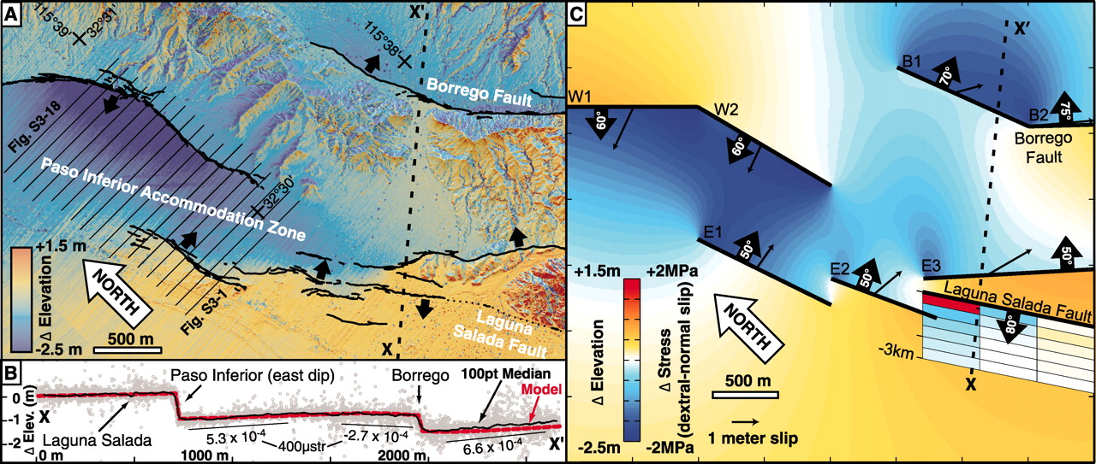

Differential LIDAR and elastic model of the southern half of the PIAZ. (A) Elevation difference map showing distributed deformation as slip steps from the NW Borrego fault into the PIAZ. East-west striping in height difference reflects noise in the pre-event LIDAR. Black arrows show fault dip direction.
M E Oskin et al. Science 2012;335:702-705
Published by AAAS
Notes:
Differential LIDAR and elastic model of the southern half of the PIAZ. (A) Elevation difference map showing distributed deformation as slip steps from the NW Borrego fault into the PIAZ. East-west striping in height difference reflects noise in the pre-event LIDAR. Black arrows show fault dip direction. (B) Swath profile of elevation difference along line X-X′ in (A). Points are within 50 m of the line as plotted. Outlier points result from noise and lateral displacement of locally steeper topography and vegetation (fig. S2). (C) Elastic model, using rectangular dislocations (table S1) and Poisson’s ratio of 0.3, constructed in Coulomb (31), showing vertical surface deformation due to imposed slip along the PIAZ fault array. The model does not reproduce fault-slip gradients, and some faults extend beyond the domain shown. Slip vectors point in the direction of motion of the fault hanging wall. Modeled slip vectors match field observations of fault slip in the area shown, with the exception of faults E1 to E3, where normal slip is 30% above the observed values to match the elevation-difference map. Coulomb stress change for oblique dextral-normal slip (rake 135°) along the Laguna Salada fault is shown for 500-by-500–m patches, from the surface to 3-km depth, projected to the surface. Stress was calculated with a shear modulus of 3 GPa, which is appropriate for damaged fault-zone rock (23).

Slide 36
Rupture model
Combined rupture model using seismic and geodetic data.
Clearly show different phases of the rupture and that the small F1 event probably triggered the large event.

Slide 37
GPS for seismology
Time history of event (first 600 seconds can also be obtained from GPS as shown on the next few slides)

Slide 38
P494

Slide 39
P496

Slide 40
P500

Slide 41
P066

Slide 42
P473 (this site is 300 km away on
San Andreas fault).
We will look at these types of data in Japan next.
Notes:
Note that this and the next site are similar distances from the epicenter but P742 is along the San Andreas. Also point out the 220-sec arrival

Slide 43
Tohoku 2011 9.0 Earthquake
The magnitude 9.0 Tohoku earthquake on March 11, 2011, which occurred near the northeast coast of Honshu, Japan, resulted from thrust faulting on or near the subduction zone plate boundary between the Pacific and North America Plates.
Following figures InSAR and GPS displacements (up to 3 meters on land, 25 meters underwater)
Density of GPS network in Japan allows the displacement and velocities from earthquake to be tracked.

Slide 44
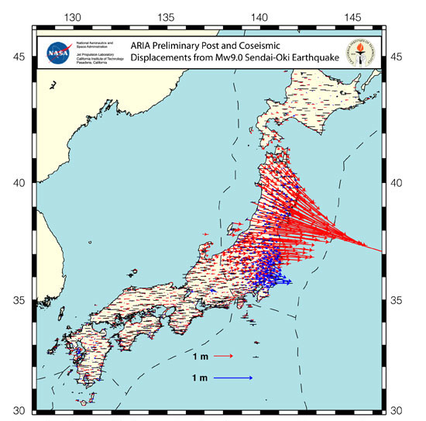
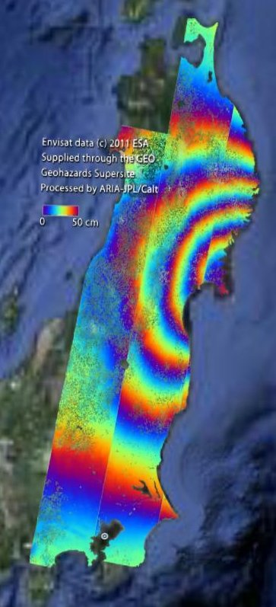
Results

Slide 45
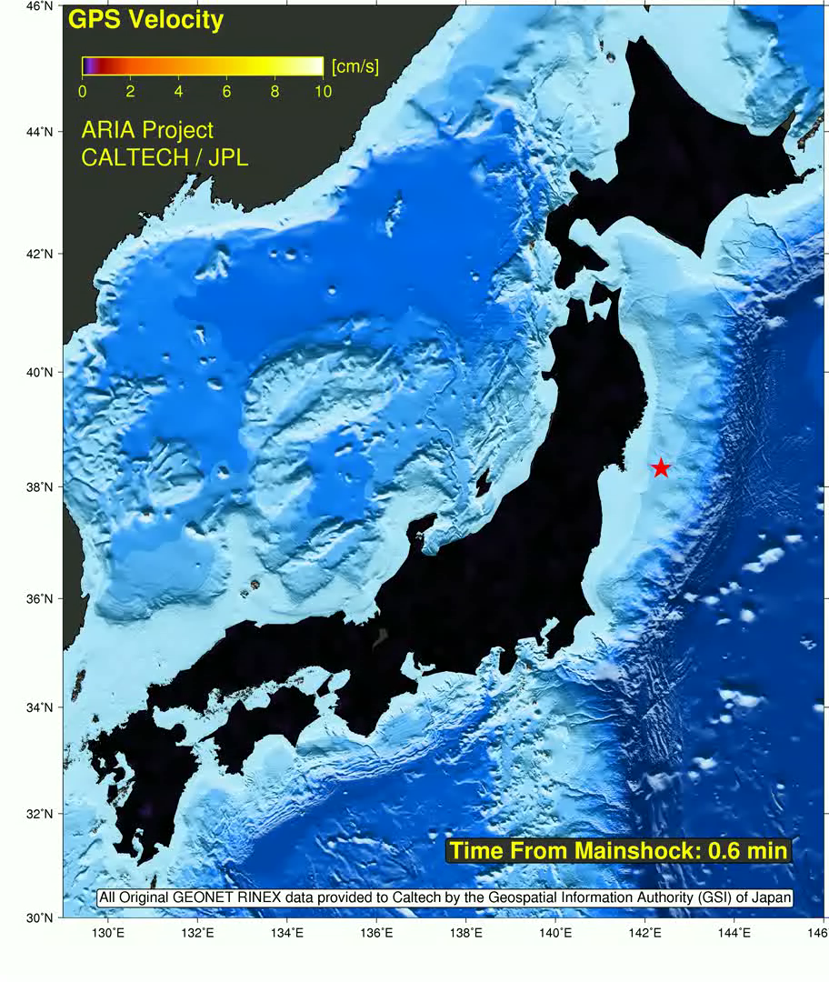
GPS velocity estimates during the Tohoku 2011 earthquake
Results from JPL ARIA project

Slide 46

GPS total displacement estimates during the Tohoku 2011 earthquake
Results from JPL ARIA project

Slide 47
Summary
Millimeter level accuracy positioning available anywhere (above water) on the Earth using GPS. Time continuous, even to rates of 10-Hz, are possible.
Modern positioning systems allow image type data to be used for precise measurements of changes in position. We have looked at some results from:
  InSAR
  LIDAR
  SPOT image analysis
  Dense GPS networks that can sense deformations moving across the network
The registration and time changes of these image type data is made possible by the global positioning system (GPS).
Current challenge: Application of these types of methods on the seafloor and underground.

