Slide 1
GAMIT Modeling Aspects Lecture 04
Thomas Herring
tah@mit.edu

Slide 2
Workshop Overview
Lectures and Tutorials Day 2
Modeling details, atmospheric delays, loading
Treatment of earthquakes, equipment changes and other effects; reference frame realization
Statistics of time series and determination of error models for velocity estimates
Analysis of Salton Sea data over a longer period of time using time series.

Slide 3
Challenges and Opportunities in GPS Measurements
“One-sided” geometry increases vertical uncertainties relative to horizontal and makes the vertical more sensitive to session length
For geophysical measurements the atmospheric delay and signal scattering are unwanted sources of noise
For meteorological applications, the atmospheric delay due to water vapor is an important signal; the hydrostatic delay and signal scattering are sources of noise
Loading of the crust by the oceans, atmosphere, and water can be either signal or noise
Local hydrological uplift or subsidence can be either signal or noise
Changes in instrumentation are to be avoided
Notes:
Signal prop affects show up in phase residuals – motions do not.
Any of these CAN be dominant in height estimates; also can be negligible
all also show up in horizontal
Scattering and monument instability influence site selection
Atm and loading influence modeling approach.

Slide 4
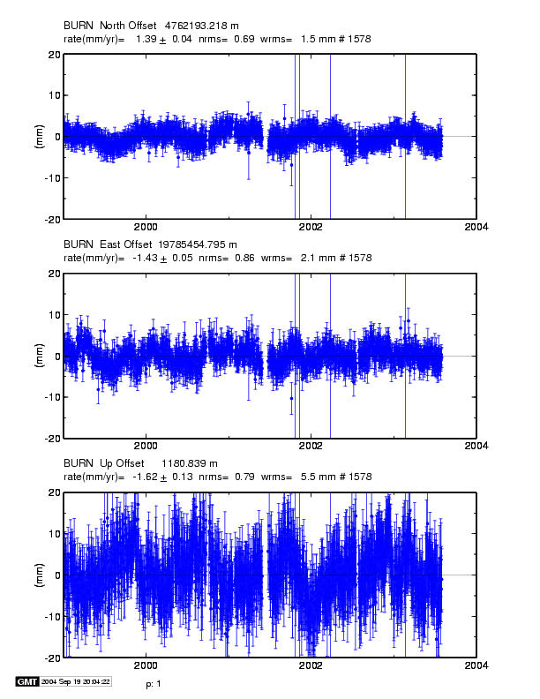
Time series for continuous station in (dry) eastern Oregon
Vertical wrms 5.5 mm, higher than the best stations. Systematics may be atmospheric or
hydrological loading,
Local hydrolology, or Instrumental effects
Notes:
Typical time series for a moderately well-behaved continuous site: eastern Oregon (low rainfaill)
2 mm horz (best are < 1 mm) 5.5 mm vertical (best are < 3 mm).
Height noise could be any combination of the four effects we’re considering .
Ignore here:
Nearly full continuous time series for BURN (4.5 yrs). Note the formal (white noise) rate uncertainties are less than 0.1 mm/yr, but the residuals are not random. We’ll compare these rates with those estimated from a 2-yr subset of the data in the next slide.

Slide 5
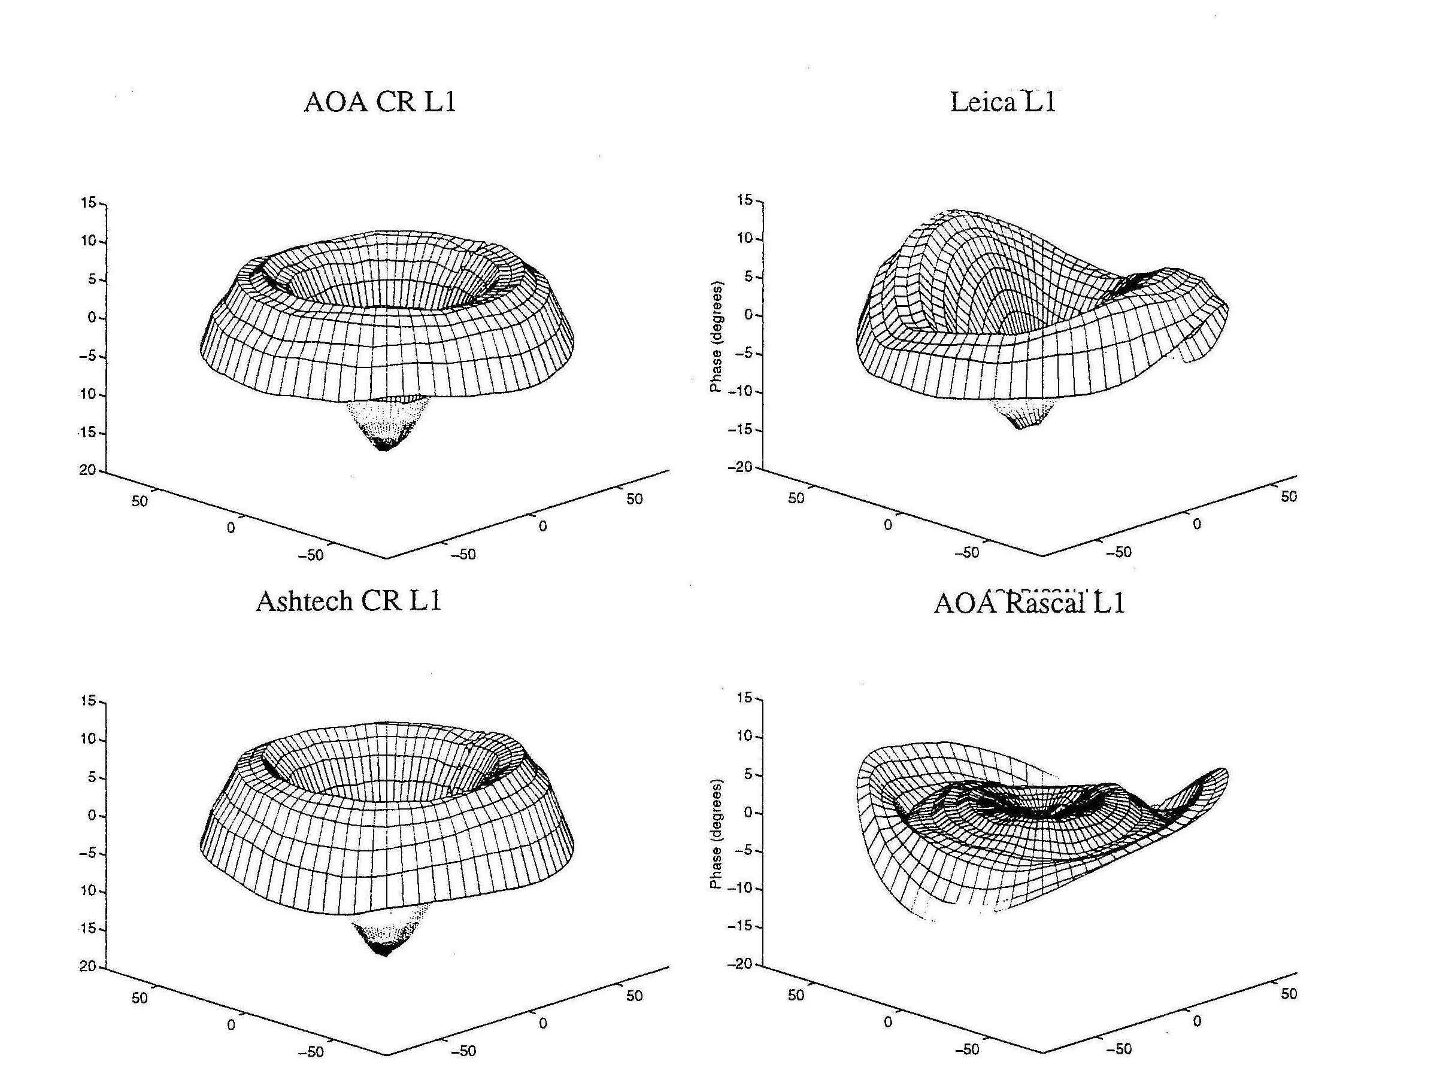
Antenna Phase Patterns
Notes:
The first problem we have is that the phase-response pattern of any physical antenna is not spherical. So the effective phase center ---the point to which you want to refer the location of the ground monument---varies as a function of elevation angle, and hence changes if you use a different minimum cutoff—which can happen when you change receivers or cables because of the change in SNR. Sometimes, the patterns also vary with azimuth, as with the Leica and Rascal antennas here, but most of the antennas used for high precision work have symmetric patterns. L1 phase variations for antennas tested by UNAVCO. Zenith values at the center and values for 10 degrees elevation at the edges. 10 deg L1 phase = 5 mm. From Rocken et a. ????

Slide 6
Modeling Antenna Phase-center Variations (PCVs)
Ground antennas
Relative calibrations by comparison with a ‘standard’ antenna (NGS, used by the IGS prior to November 2006)
Absolute calibrations with mechanical arm (GEO++) or anechoic chamber
May depend on elevation angle only or elevation and azimuth
Current models are radome-dependent
Errors for some antennas can be several cm in height estimates
Satellite antennas (absolute)
Estimated from global observations (T U Munich)
Differences with evolution of SV constellation mimic scale change
Recommendation for GAMIT: Use latest IGS absolute ANTEX file (absolute) with AZ/EL for ground antennas and ELEV (nadir angle) for SV antennas
(MIT file augmented with NGS values for antennas missing from IGS)

Slide 7
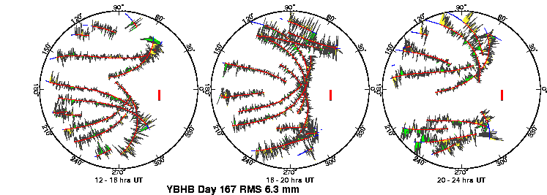
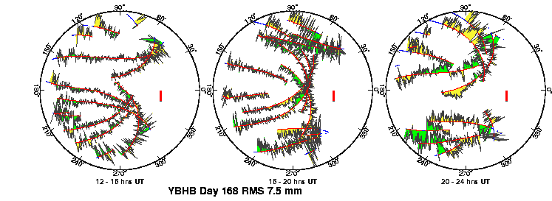
Multipath and Water Vapor Can be Seen in the Phase Residuals
Notes:
Review of sky plots: North to the right; red lines are satellite paths in the sky; green and red for positive and negative residuals (sign not important, visual aid); red bar is scale (10 mm). Plots are for the same 12-hour period on two successive days. Repeating high-frequency patterns are multipath; patterns that do not repeat are water vapor.

Slide 8
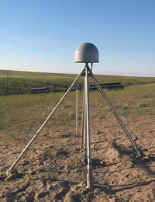
Top: PBO station near Lind, Washington.
Bottom: BARD station CMBB at Columbia College, California
Notes:
Review of phase vs elevation plots: black dots are the residuals (as in last slide) with all satellites lumped together and plotted versus height above the horizon. Red line is the mean; green lines are GAMIT’s model for weighting the observations. Mutlipath and lower-frequency signal scattering (reflections within the antenna + mount) are a function of the type of mount, height above the ground, and the reflective environment around the antenna. We now routinely create phase vs elevation plots in all of our processing. Here are two examples from continuous stations from the west US, The top one is a new PBO station in Eastern Washington. Except for the thin rods supporting the antenna, the support and the area around the antenna is “clean”, and the phase pattern quite flat. An older continuous station, mounted on a pillar. Note the low-frequency reflections at low elevation angles, indicative of higher multipath and/or an inadequate model for the antenna (+ mount) phase center variations.

Slide 9
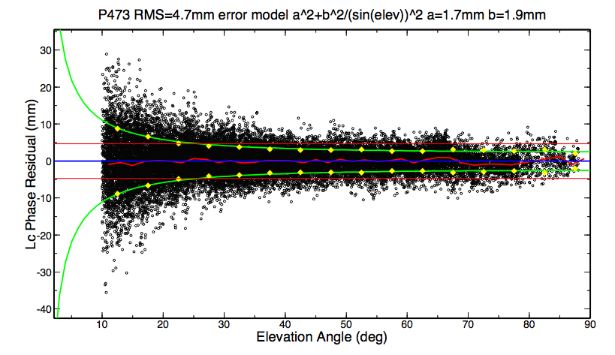
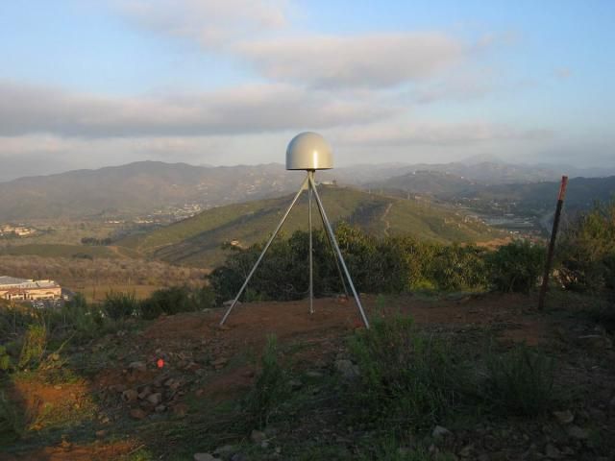
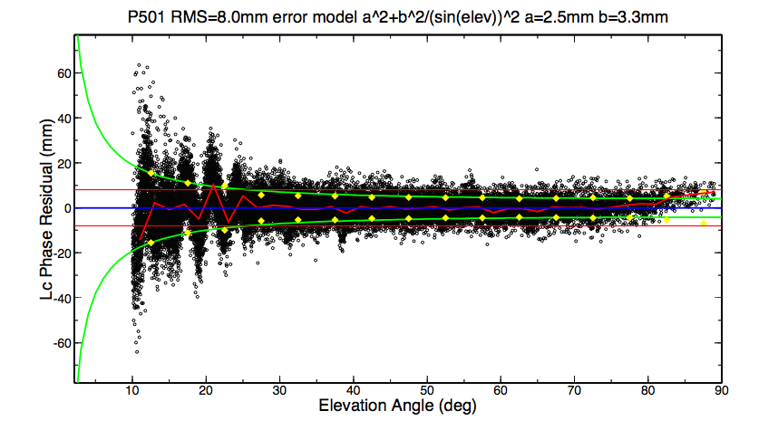
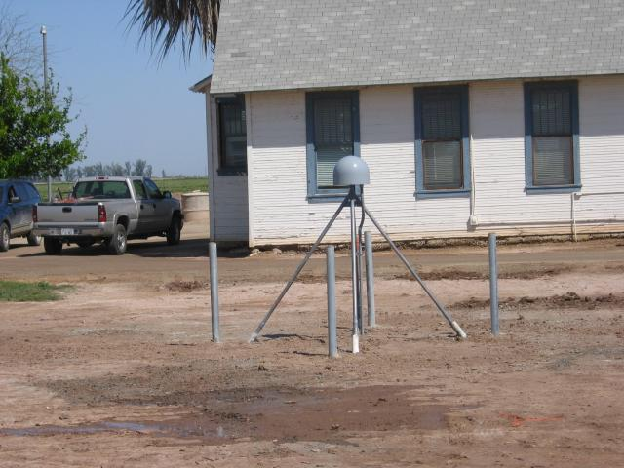
More examples
Flat, smooth ground (see web site as well)

Slide 10
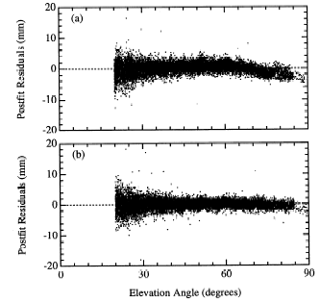
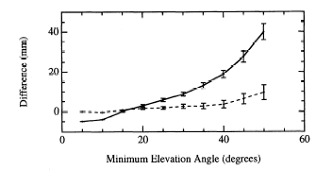
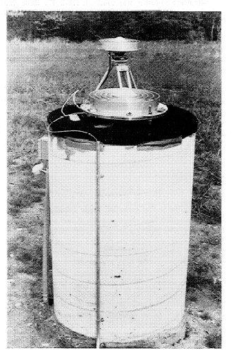
Left: Phase residuals versus elevation for Westford pillar, without (top) and with (bottom) microwave absorber.
Right: Change in height estimate as a function of minimum elevation angle of observations; solid line is with the unmodified pillar, dashed with microwave absorber added
[From Elosequi et al.,1995]
Notes:
The GPS research group at Harvard noticed that the height they estimated for the pillar at the Haystack Observatory (near Boston) was sensitive to the cutoff angle they used in their processing (upper right). The phase vs elevation plot (upper left) show swhy: notice the bend in the curve, indicative of a poor model for the antenna phase center variations. They related the pattern not the antenna itself but to the metal plate imbedded in the top of the concrete pillar. When they put microwave absorbing material beneath the antenna, the pattern flattened and the sensitivity to cutoff angle went away.

Slide 11
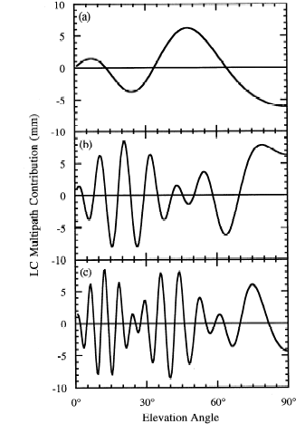
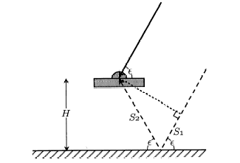
Antenna Ht
0.15 m
0.6 m
Simple geometry for incidence of a direct and reflected signal
1 m
Multipath contributions to observed phase for three different antenna heights [From Elosegui et al, 1995]
Notes:
This model for the period of reflections as a function of height of the antenna illustrates the problem when an antenna is mounted within about a wavelength of a reflective surface. For an antenna mounted 1-2 m above the surface, the variations will be of the order of minutes, and tend to have low, though still significant correlatations with the signature of the station’s coordinates and the atmospheric delay. Once you get within a half-meter, though, the longer period variations are a real problem. And this is even without taking into account the interaction with the antenna structure.

Slide 12
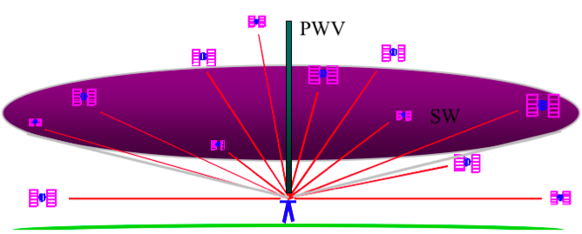
Atmospheric Delay
The signal from each GPS satellite is delayed by an amount dependent on the pressure and humidity and its elevation above the horizon. We invert the measurements to estimate the average delay at the zenith (green bar).
( Figure courtesy of COSMIC Program )

Slide 13
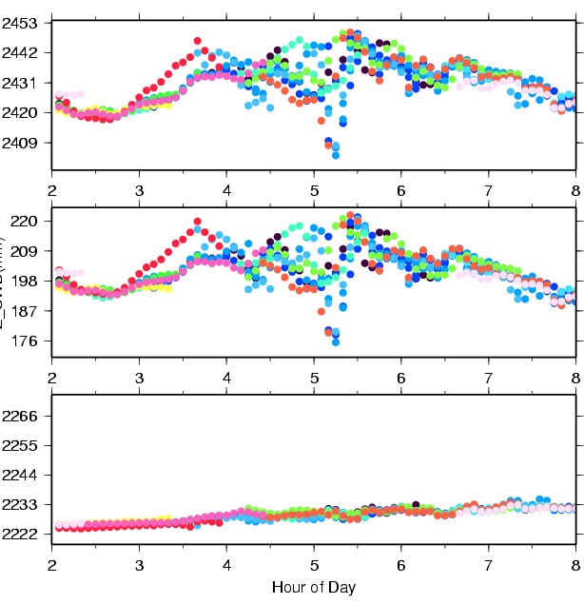
Zenith Delay from Wet and Dry Components of the Atmosphere
Colors are for different satellites
Total delay is ~2.5 meters
Variability mostly caused by wet component.
Wet delay is ~0.2 meters
Obtained by subtracting the hydrostatic (dry) delay.
Hydrostatic delay is ~2.2 meters; little variability between satellites or over time; well calibrated by surface pressure.
Plot courtesy of J. Braun, UCAR
Notes:
The three figures on the left show time series of ZHD (bottom), ZWD (middle), and ZTD (top) simulated from a MM5 3-km model simulation of a squall line. The

Slide 14
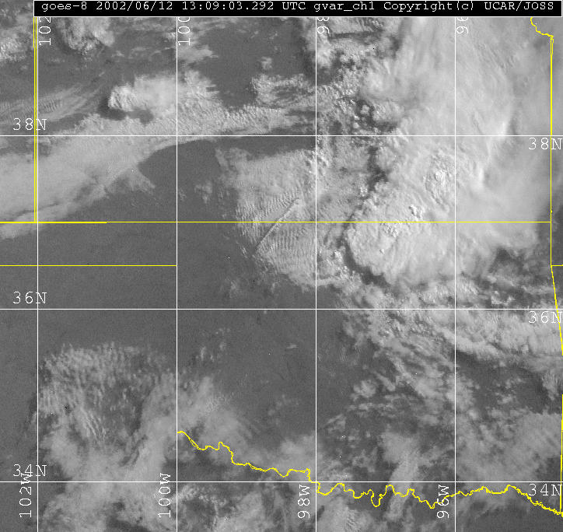
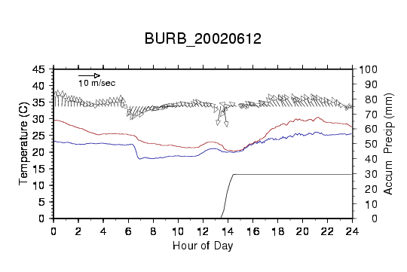
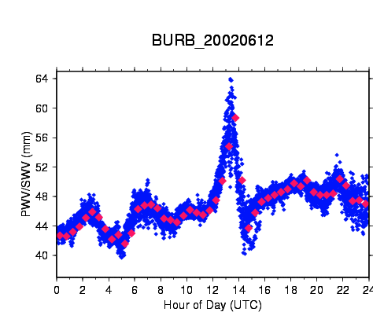
Example of GPS Water Vapor Time Series
GOES IR satellite image of central US on left with location of GPS station shown as red star.
Time series of temperature, dew point, wind speed, and accumulated rain shown in top right. GPS PW is shown in bottom right. Increase in PW of more than 20mm due to convective system shown in satellite image.
Notes:
GOES 8 image at 1309 UTC and GPS PW/SW for station BURB

Slide 15
P549 Position residuals
Notes:
Example of systematic direction for residuals that may be related to local topography and weather conditions.

Slide 16
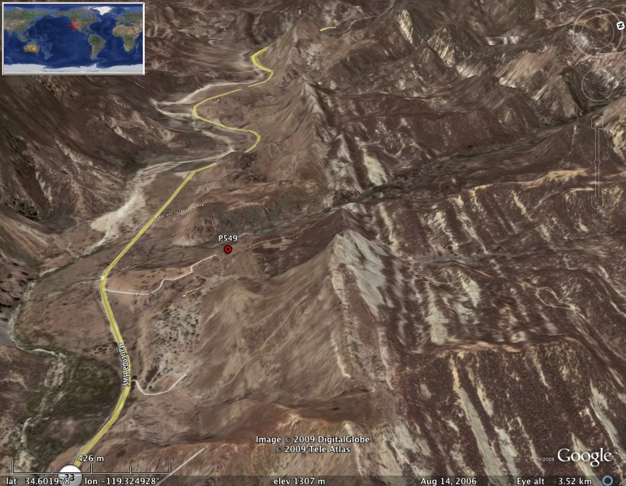
Location of P549 (Google Earth)

Slide 17
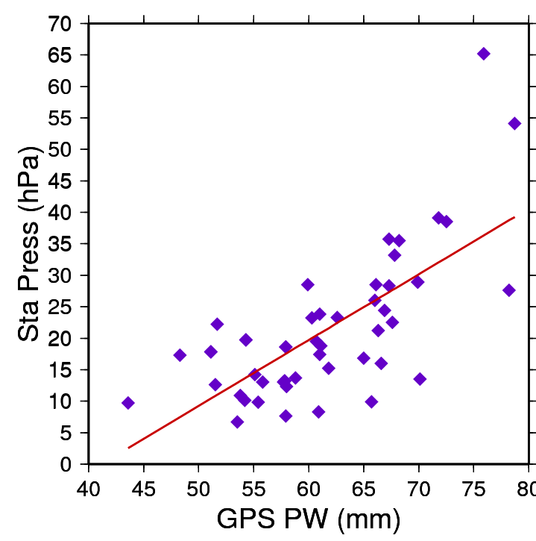
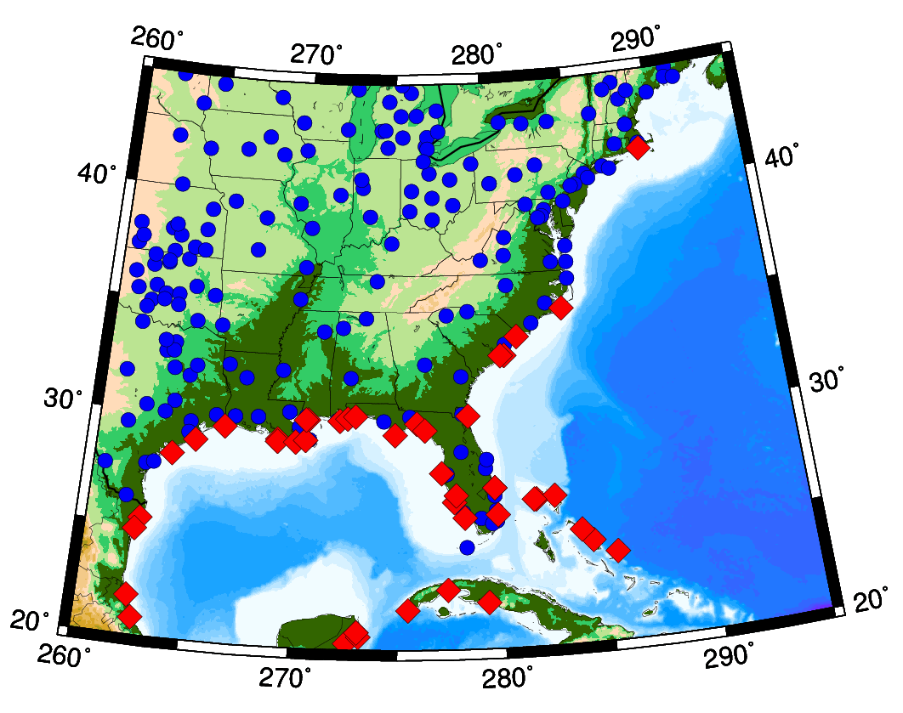
Water Vapor as a Proxy for Pressure in Storm Prediction
GPS stations (blue) and locations of hurricane landfalls
Correlation (75%) between GPS-measured precipitable water and drop in surface pressure for stations within 200 km of landfall.
J.Braun, UCAR
Notes:
17
The map on the lower left shows Suominet GPS stations (in blue), and locations of hurricane landfall from 2003-2005. The scatterplot on the upper right shows the correlation between GPS PW and drop in surface pressure (1013 - Surf_Press) for stations within 200km of hurricane landfall. The correlation between PW and surface pressure is -0.71. This high correlation is a positive sign that GPS PW can be used to improve intensity forecasts.

Slide 18
Effect of the Neutral Atmosphere on GPS Measurements
Slant delay = (Zenith Hydrostatic Delay) * (“Dry” Mapping Function) +
(Zenith Wet Delay) * (Wet Mapping Function) +
(Gradient Delay NS) ( Gradient Mapping Function) * Cos/Sin(Azimuth)
To recover the water vapor (ZWD) for meteorological studies, you must have a very accurate measure of the hydrostatic delay (ZHD) from a barometer at the site.
For height studies, a less accurate model for the ZHD is acceptable, but still important because the wet and dry mapping functions are different (see next slides)
The mapping functions used can also be important for low elevation angles
For both a priori ZHD and mapping functions, you have a choice in GAMIT of using values computed at 6-hr intervals from numerical weather models (VMF1 grids) or an analytical fit to 20-years of VMF1 values, GPT and GMF (defaults)

Slide 19
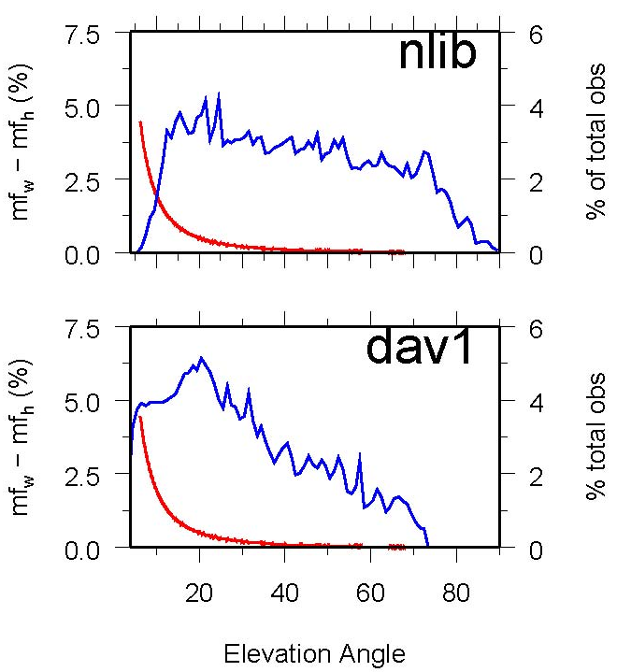
Mapping function effects
Mapping functions differ and this means hydrostatic and wet delays are coupled in the estimation.
Example: Percent difference (red) between hydrostatic and wet mapping functions for a high latitude (dav1) and mid-latitude site (nlib). Blue shows percentage of observations at each elevation angle. From Tregoning and Herring [2006].
Notes:
Problem is that the distribution of satellites on sky for different latitudes creates a bias in height estimates.

Slide 20
Effect of surface pressure errors
a) surface pressure derived from “standard” sea level pressure and the mean surface pressure derived from the GPT model. b) station heights using the two sources of a priori pressure. c) Relation between a priori pressure differences and height differences. Elevation-dependent weighting was used in the GPS analysis with a minimum elevation angle of 7 deg.

Slide 21
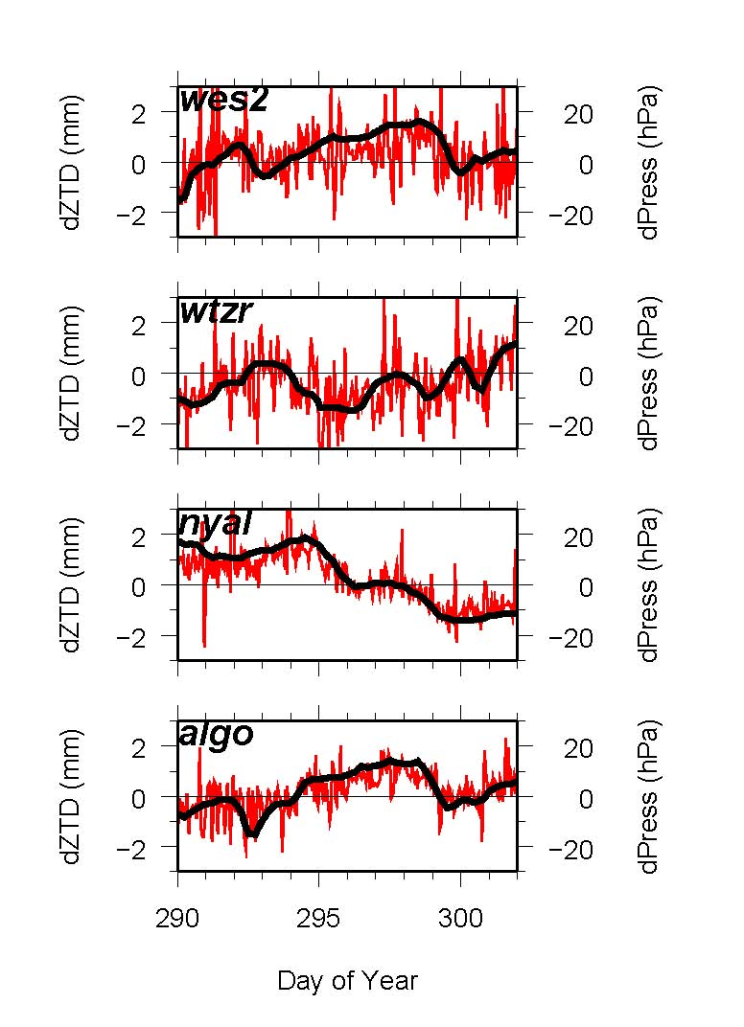
Short-period Variations in Surface Pressure not Modeled by GPT
Differences in GPS estimates of ZTD at Algonquin, Ny Alessund, Wettzell and Westford computed using static or observed surface pressure to derive the a priori. Height differences will be about twice as large. (Elevation-dependent weighting used).
Notes:
10-day span of ZD estimates from GAMIT at 4 stations, showing…
DIFFERENCES in ZTD (red) vs differences (ERROR) in pressure (black)
NOTE high correlation.

Slide 22
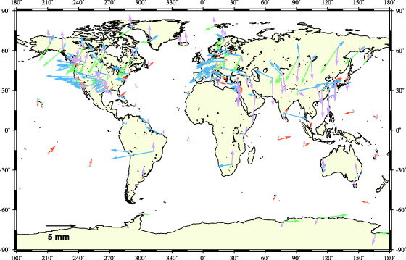
Annual Component of Vertical Loading
Atmosphere (purple)
2-5 mm
Water/snow (blue/green)
2-10 mm
Nontidal ocean (red)
2-3 mm
From Dong et al. J. Geophys. Res., 107, 2075, 2002
Notes:
The only loading effect we currently account for in our processing are those from ocean tides. For these the current models are quite good for most parts of the world, but probably inadequate for high latitudes (above the TOPEX altimeter coverage) and around some complicated shorelines. (High local tides do not mean large errors, however, because it’s the total mass of the water that matters.)
This map is taken from a paper by Danan Dong (former MIT student) and his colleagues at JPL, Scripps, and GSI in Japan. They estimated annual and semi-annual terms in vertical GPS station position and attempted to match these with predicted motions derived from a variety of sources. They could not obtain sufficient correlation overall to validate the models, but they’ve given us rough estimates of the amplitudes and geographical distribution of the induced displacements.
Tom Herring, with Tonie VanDam first detected atmospheric loading effects in VLBI data 10 years ago but neither the global pressure fields nor the data coverage were sufficient to develop and test good models. There’s now an operational program to use the NCEP and European Center analyses to compute loading corrections on a global grid and we’re planning to test these in our GPS analyses over the next few months.

Slide 23
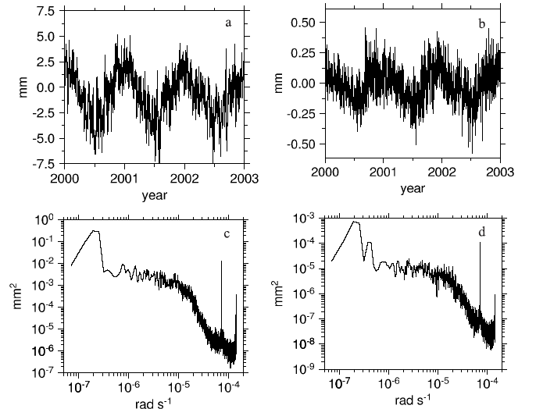
Atmospheric pressure loading near equator
Vertical (a) and north (b) displacements from pressure loading at a site in South Africa. Bottom is power spectrum. Dominant signal is annual. From Petrov and Boy (2004)
Notes:
The next three slides are from a study by Leonid Petrov and Jean-Paul Boy at Goddard to repeat the Herring and VanDam study with current pressure fields and VLBI data. This slide shows a 3-year time series and spectra for vertical and horizontal loading at low latitudes The horizontal signal is quite small, the vertical is quite detectable with GPS or VLBI measurements. The dominant signals are diurnal and semi-diurnal (narrow spikes to right), and wide-band annual and semiannual. There is relatively little power at periods below 10 days.

Slide 24
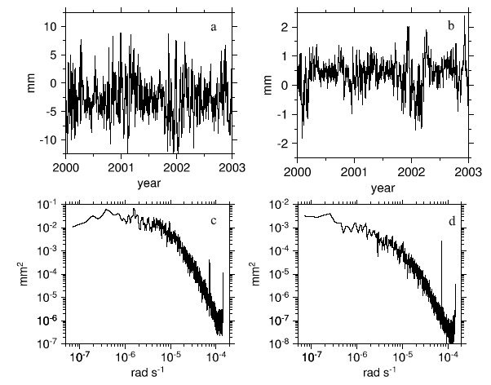
Atmospheric pressure loading at mid-latitudes
Vertical (a) and north (b) displacements from pressure loading at a site in Germany. Bottom is power spectrum. Dominant signal is short-period.
Notes:
At mid-latitudes, the circulation of low and high pressure systems with periods of 5-10 days is typical, and the annual and semiannual signal is relatively weak. (The inverted barometer assumption for the oceanic response may not be valid at these short periods.) Effect larger and the horizontal signal can be significant.

Slide 25
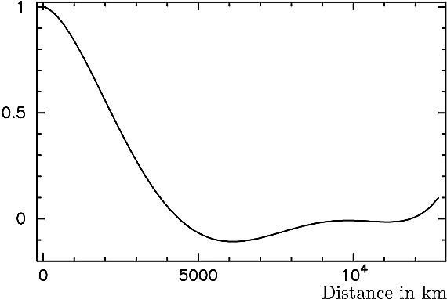
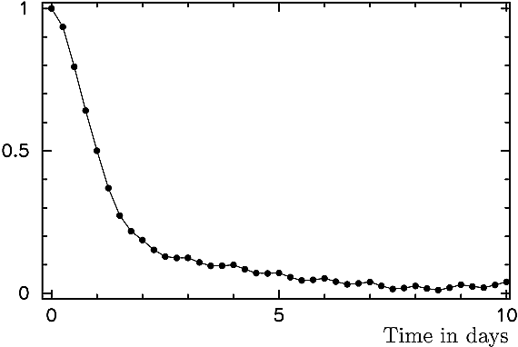
Atmospheric delay correlation
Spatial and temporal autocorrelation of atmospheric pressure loading (functions for mid-latitude site Algonquin, Canada).
From Petrov and Boy, J. Geophys. Res., 109, B03405, 2004
Notes:
The autocorrelation functions tell us a lot about what we should see in the data and how to design our measurements. We expect to get a lot of cancellation when we’re measuring regional networks of less than 1000 km. And we will expect to average out a lot of the temporal variation (at mid-latitudes) if we separate measurements of a given station by more than two days.
LAST SLIDE

Slide 26
GAMIT Options for Modeling the Troposphere and Loading
For height studies, the most accurate models for a priori ZHD and mapping functions are the VMF1 grids computed from numerical weather models at 6-hr intervals.
For most applications it is sufficient to use the analytical models for a priori ZHD (GPT) and mapping functions (GMF) fit to 20 years of VMF1.
For meteorological studies, you need to use surface pressure measured at the site to compute the wet delay, but this can be applied after the data processing (sh_met_util), and it is sufficient to use GPT in the GAMIT processing
For height studies, atmospheric loading from numerical weather models (ATML grids) should also be applied. (ZHD and ATML are correlated, so don’t use one set of grids without the other)

Slide 27
Summary
For individual locations in regional network, atmospheric delay modeling, multipath and the stability of monumentation are usually the largest error contributors
For survey mode measurements, set-up errors can also be large
The other largest uncertainty and the way results are viewed can arise from the reference frame realization.

